Slide 1
Video 12 - Hypothesis testing
Steve Simon

Slide 2
Pop quiz
A research paper computes a p-value of 0.45. How would you interpret this p-value?
Strong evidence for the null hypothesis
Strong evidence for the alternative hypothesis
Little or no evidence for the null hypothesis
Little or no evidence for the alternative hypothesis
More than one answer above is correct.
I do not know the answer.
Notes:
I gave a talk about ten years ago, and I had a “pop quiz” to start out the talk. It turns out that I was a bit careless in how I worded the question, but I decided to keep it in for future talks about p-values to help illustrate an important point. I won’t ask you for the answer just yet, but here is the question.
A research paper computes a p-value of 0.45. How would you interpret this p-value?
Strong evidence for the null hypothesis;
Strong evidence for the alternative hypothesis;
Little or no evidence for the null hypothesis;
Little or no evidence for the alternative hypothesis;
More than one answer above is correct;
I do not know the answer.

Slide 3
Another question
A research paper computes a confidence interval for a relative risk of 0.82 to 3.94. What does this confidence interval tell you.
The result is statistically significant and clinically important.
The result is not statistically significant, but is clinically important.
The result is statistically significant, but not clinically important.
The result is not statistically significant, and not clinically important.
The result is ambiguous.
I do not know the answer.
Notes:
Here’s another question to toss out, but this time it is not poorly worded.
A research paper computes a confidence interval for a relative risk of 0.82 to 3.94. What does this confidence interval tell you.
The result is statistically significant and clinically important.
The result is not statistically significant, but is clinically important.
The result is statistically significant, but not clinically important.
The result is not statistically significant, and not clinically important.
The result is ambiguous.
I do not know the answer.

Slide 4
What is a population?
A population is a collection of items of interest often defined in terms of
demography,
geography,
occupation,
time,
care requirements,
diagnosis, or
some combination of the above.
Notes:
Here’s a definition of a population that I found somewhere but then I lost the link. So if anyone ever runs across this list of characteristics of a population, please let me know. It is too clever a list for me to have figured it out by myself.
A population is a collection of items of research. In clinical research, the population is often a collection of people, sharing some commmon features. They may all be in the same demographic group, the may all come from the same area, they may all have the same job, they may be getting the same type of medical care, they may have the same diseases, or it may be a combination of these items.

Slide 5
Example of a population
Population: All infants born in the state of Missouri during the 1995 calendar year who have one or more visits to the Emergency Room during their first year of life.
Notes:
Here’s an example that hits on about all these.
All infants (demography)
born in the state of Missouri (geography)
during the 1995 calendar year (time)
who have one or more visits to the Emergency Room (care requirements)
during their first year of life (time, again)

Slide 6
What is a sample?
A sample is a subset of a population
Small and manageable
Is your sample representative?
Your goal
Make inferences about the population
Using information from the sample
Notes:
A sample is a subet of a population. Usually it is of a much smaller size than the population. It has to be small enough to be manageable.
A key question you should always is whether your sample is representative of your population.
The primary goal of much research is to use information collected from a sample to try to characterize a certain population. As such, you should pay a lot of attention to how representative the sample is of the population.
If there are problems, with representativeness, consider redefining your population a bit more narrowly. For example, a sample of 85 smokers between the ages of 13 and 18 in Rochester, Minnesota who respond to an advertisement about participation in a smoking cessation program might not be considered representative of the population of all teenage smokers, because the participants selected themselves. The sample might be more representative if we restrict our population to those teenage smokers who want to quit.

Slide 7
More definitions for hypothesis testing
Parameter
Computed for a population
Almost always unknown
Statistic
Computed for a sample
Estimate of population parameter
Sampling error
Notes:
A parameter is a number computed from a population. Since the population is often very large, it is often impossible to compute a parameter.
A statistic is a number computed from a sample. Since the sample is small enough to be manageable, the values of the statistic are computed with the hope that they will be good estimates of the corresponding population parameter.

Slide 8
Hypotheses
Null hypothesis
Designated by $H_{0}$
No change, no effect
Alternative hypothesis
Designated by $H_{a}$
Notes:
Researchers will often designate a null and alternative hypothesis. The null hypothesis (H0) is traditionally reserved for a hypothesis involving no effect.

Slide 9
Comparison of continuous outcome for two populations
Most common research problem
Use subscripts 1 and 2
Population parameters ($μ_{1}$ and $μ_{2}$)
Sample statistics (${\overline{X}}_{1}$ and ${\overline{X}}_{2}$)
$H_{0} μ_{1}−μ_{2}=0$
Accept $H_{0}$ if ${\overline{X}}_{1}−{\overline{X}}_{2}$ is close to zero.
Notes:
The most frequent hypothesis involves a comparison of continuous outcomes between two groups, a treatment group and a control group. These are designated by the subscripts 1 and 2, but there is no standard that says that 1 is the treatment and 2 is the control. It is just as likely to be the reverse. You have to look for some context to make sure you know which subscript is which.
The null hypothesis is that the difference in population means is zero. You compute the difference in sample means and accept the null hypothesis if that difference is close to zero.
How close is close? It depends on how much sampling error you have.

Slide 10
Comparison of binary outcome for two populations
Population parameters ($π_{1}$ and $π_{2}$)
Sample statistics ($p_{1}$ and $p_{2}$)
$H_{0} π_{1}−π_{2}=0$
Accept $H_{0}$ if $p_{1}−p_{2}$ is close to zero.
Notes:
The most frequent hypothesis involves a comparison of continuous outcomes between two groups, a treatment group and a control group. These are designated by the subscripts 1 and 2, but there is no standard that says that 1 is the treatment and 2 is the control. It is just as likely to be the reverse. You have to look for some context to make sure you know which subscript is which.
The null hypothesis is that the difference in population means is zero. You compute the difference in sample means and reject the null hypothesis if that difference is far from zero.

Slide 11
What is a Type I Error?
In your research, you specify a null hypothesis (typically labeled H0) and an alternative hypothesis (typically labeled Ha, or sometimes H1). By tradition, the null hypothesis corresponds to no change. When you are using Statistics to decide between these two hypothesis, you have to allow for the possibility of error. Actually, if you are using any other procedure, you should still allow for the possibility of error, but we statisticians are the only ones honest enough to admit this. A Type I error is rejecting the null hypothesis when the null hypothesis is true.

Slide 12
Example
Consider a new drug that we will put on the market if we can show that it is better than a placebo. In this context, H0 would represent the hypothesis that the average improvement (or perhaps the probability of improvement) among all patients taking the new drug is equal to the average improvement (probability of improvement) among all patients taking the placebo. A Type I error would be allowing an ineffective drug onto the market.

Slide 13
What is a Type II Error?
A Type II error is accepting the null hypothesis when the null hypothesis is false. You should always remember that it is impossible to prove a negative. Some statisticians will emphasize this fact by using the phrase “fail to reject the null hypothesis” in place of “accept the null hypothesis.” The former phrase always strikes me as semantic overkill. Many studies have small sample sizes that make it difficult to reject the null hypothesis, even when there is a big change in the data. In these situations, a Type II error might be a possible explanation for the negative study results.

Slide 14
Example
Consider a new drug that we will put on the market if we can show that it is better than a placebo. In this context, H0 would represent the hypothesis that the average improvement (or perhaps the probability of improvement) among all patients taking the new drug is equal to the average improvement (probability of improvement) among all patients taking the placebo. A Type II error would be keeping an effective drug off the market.

Slide 15
What is a p-value?
Dear Professor Mean: Can you give me a simple explanation of what a p-value is?
A p-value is a measure of how much evidence we have against the null hypothesis. The null hypothesis, traditionally represented by the symbol H0, represents the hypothesis of no change or no effect.
The smaller the p-value, the more evidence we have against H0. It is also a measure of how likely we are to get a certain sample result or a result “more extreme,” assuming H0 is true. The type of hypothesis (right tailed, left tailed or two tailed) will determine what “more extreme” means.
###p-value
Much research involves making a hypothesis and then collecting data to test that hypothesis. In particular, researchers will set up a null hypothesis, a hypothesis that presumes no change or no effect of a treatment. Then these researchers will collect data and measure the consistency of this data with the null hypothesis.
The p-value measures consistency by calculating the probability of observing the results from your sample of data or a sample with results more extreme, assuming the null hypothesis is true. The smaller the p-value, the greater the inconsistency.

Slide 16
p-value
Traditionally, researchers will reject a hypothesis if the p-value is less than 0.05. Sometimes, though, researchers will use a stricter cut-off (e.g., 0.01) or a more liberal cut-off (e.g., 0.10). The general rule is that a small p-value is evidence against the null hypothesis while a large p-value means little or no evidence against the null hypothesis. Please note that little or no evidence against the null hypothesis is not the same as a lot of evidence for the null hypothesis.
It is easiest to understand the p-value in a data set that is already at an extreme. Suppose that a drug company alleges that only 50% of all patients who take a certain drug will have an adverse event of some kind. You believe that the adverse event rate is much higher. In a sample of 12 patients, all twelve have an adverse event.

Slide 17
p-value
The data supports your belief because it is inconsistent with the assumption of a 50% adverse event rate. It would be like flipping a coin 12 times and getting heads each time.
The p-value, the probability of getting a sample result of 12 adverse events in 12 patients assuming that the adverse event rate is 50%, is a measure of this inconsistency. The p-value, 0.000244, is small enough that we would reject the hypothesis that the adverse event rate was only 50%.

Slide 18
p-value
A large p-value should not automatically be construed as evidence in support of the null hypothesis. Perhaps the failure to reject the null hypothesis was caused by an inadequate sample size. When you see a large p-value in a research study, you should also look for one of two things:
a power calculation that confirms that the sample size in that study was adequate for detecting a clinically relevant difference; and/or
a confidence interval that lies entirely within the range of clinical indifference.
You should also be cautious about a small p-value, but for different reasons. In some situations, the sample size is so large that even differences that are trivial from a medical perspective can still achieve statistical significance.

Slide 19
Practice exercises
Read the following abstracts. Interpret each of the p-values presented in these abstracts.
The Outcome of Extubation Failure in a Community Hospital Intensive Care Unit: A Cohort Study. Seymour CW, Martinez A, Christie JD, Fuchs BD. Critical Care 2004, 8:R322-R327 (20 July 2004) Introduction: Extubation failure has been associated with poor intensive care unit (ICU) and hospital outcomes in tertiary care medical centers. Given the large proportion of critical care delivered in the community setting, our purpose was to determine the impact of extubation failure on patient outcomes in a community hospital ICU. Methods: A retrospective cohort study was performed using data gathered in a 16-bed medical/surgical ICU in a community hospital. During 30 months, all patients with acute respiratory failure admitted to the ICU were included in the source population if they were mechanically ventilated by endotracheal tube for more than 12 hours. Extubation failure was defined as reinstitution of mechanical ventilation within 72 hours (n = 60), and the control cohort included patients who were successfully extubated at 72 hours (n = 93). Results: The primary outcome was total ICU length of stay after the initial extubation. Secondary outcomes were total hospital length of stay after the initial extubation, ICU mortality, hospital mortality, and total hospital cost. Patient groups were similar in terms of age, sex, and severity of illness, as assessed using admission Acute Physiology and Chronic Health Evaluation II score (P > 0.05). Both ICU (1.0 versus 10 days; P < 0.01) and hospital length of stay (6.0 versus 17 days; P < 0.01) after initial extubation were significantly longer in reintubated patients. ICU mortality was significantly higher in patients who failed extubation (odds ratio = 12.2, 95% confidence interval [CI] = 1.5ï¿½101; P < 0.05), but there was no significant difference in hospital mortality (odds ratio = 2.1, 95% CI = 0.8ï¿½5.4; P < 0.15). Total hospital costs (estimated from direct and indirect charges) were significantly increased by a mean of US$33,926 (95% CI = US$22,573ï¿½45,280; P < 0.01). Conclusion: Extubation failure in a community hospital is univariately associated with prolonged inpatient care and significantly increased cost. Corroborating data from tertiary care centers, these adverse outcomes highlight the importance of accurate predictors of extubation outcome.
Elevated White Cell Count in Acute Coronary Syndromes: Relationship to Variants in Inflammatory and Thrombotic Genes. Byrne CE, Fitzgerald A, Cannon CP, Fitzgerald DJ, Shields DC. BMC Medical Genetics 2004, 5:13 (1 June 2004) Background: Elevated white blood cell counts (WBC) in acute coronary syndromes (ACS) increase the risk of recurrent events, but it is not known if this is exacerbated by pro-inflammatory factors. We sought to identify whether pro-inflammatory genetic variants contributed to alterations in WBC and C-reactive protein (CRP) in an ACS population. Methods: WBC and genotype of interleukin 6 (IL-6 G-174C) and of interleukin-1 receptor antagonist (IL1RN intronic repeat polymorphism) were investigated in 732 Caucasian patients with ACS in the OPUS-TIMI-16 trial. Samples for measurement of WBC and inflammatory factors were taken at baseline, i.e. Within 72 hours of an acute myocardial infarction or an unstable angina event. Results: An increased white blood cell count (WBC) was associated with an increased C-reactive protein (r = 0.23, p < 0.001) and there was also a positive correlation between levels of β-fibrinogen and C-reactive protein (r = 0.42, p < 0.0001). IL1RN and IL6 genotypes had no significant impact upon WBC. The difference in median WBC between the two homozygote IL6 genotypes was 0.21/mm3 (95% CI = -0.41, 0.77), and -0.03/mm3 (95% CI = -0.55, 0.86) for IL1RN. Moreover, the composite endpoint was not significantly affected by an interaction between WBC and the IL1 (p = 0.61) or IL6 (p = 0.48) genotype. Conclusions: Cytokine pro-inflammatory genetic variants do not influence the increased inflammatory profile of ACS patients.
Is There a Clinically Significant Gender Bias in Post-Myocardial Infarction Pharmacological Management in the Older (>60) Population of a Primary Care Practice? Di Cecco R, Patel U, Upshur REG. BMC Family Practice 2002, 3:8 (3 May 2002) Background: Differences in the management of coronary artery disease between men and women have been reported in the literature. There are few studies of potential inequalities of treatment that arise from a primary care context. This study investigated the existence of such inequalities in the medical management of post myocardial infarction in older patients. Methods: A comprehensive chart audit was conducted of 142 men and 81 women in an academic primary care practice. Variables were extracted on demographic variables, cardiovascular risk factors, medical and non-medical management of myocardial infarction. Results: Women were older than men. The groups were comparable in terms of cardiac risk factors. A statistically significant difference (14.6%: 95% CI 0.048ï¿½28.7 p = 0.047) was found between men and women for the prescription of lipid lowering medications. 25.3% (p = 0.0005, CI 11.45, 39.65) more men than women had undergone angiography, and 14.4 % (p = 0.029, CI 2.2, 26.6) more men than women had undergone coronary artery bypass graft surgery. Conclusion: Women are less likely than men to receive lipid-lowering medication which may indicate less aggressive secondary prevention in the primary care setting.

Slide 20
What is a confidence interval?
Dear Professor Mean: Can you give me a simple explanation of what a confidence interval is?
We statisticians have a habit of hedging our bets. We always insert qualifiers into our reports, warn about all sorts of assumptions, and never admit to anything more extreme than probable. There’s a famous saying: “Statistics means never having to say you’re certain.”
We qualify our statements, of course, because we are always dealing with imperfect information. In particular, we are often asked to make statements about a population (a large group of subjects) using information from a sample (a small, but carefully selected subset of this population). No matter how carefully this sample is selected to be a fair and unbiased representation of the population, relying on information from a sample will always lead to some level of uncertainty.

Slide 21
Short Explanation
A confidence interval is a range of values that tries to quantify this uncertainty. Consider it as a range of plausible values. A narrow confidence interval implies high precision; we can specify plausible values to within a tiny range. A wide interval implies poor precision; we can only specify plausible values to a broad and uninformative range.
Consider a recent study of homoeopathic treatment of pain and swelling after oral surgery (Lokken 1995). When examining swelling 3 days after the operation, they showed that homoeopathy led to 1 mm less swelling on average. The 95% confidence interval, however, ranged from -5.5 to 7.5 mm. From what little I know about oral surgery, this appears to be a very wide interval. This interval implies that neither a large improvement due to homoeopathy nor a large decrement could be ruled out.
Generally when a confidence interval is very wide like this one, it is an indication of an inadequate sample size, an issue that the authors mention in the discussion section of this paper.

Slide 22
How to Interpret a Confidence Interval
When you see a confidence interval in a published medical report, you should look for two things. First, does the interval contain a value that implies no change or no effect? For example, with a confidence interval for a difference look to see whether that interval includes zero. With a confidence interval for a ratio, look to see whether that interval contains one.
Here’s an example of a confidence interval that contains the null value. The interval shown below implies no statistically significant change.
Figure 2.1
Here’s an example of a confidence interval that excludes the null value. If we assume that larger implies better, then the interval shown below would imply a statistically significant improvement.
Figure 2.2 (1222 bytes)
Here’s a different example of a confidence interval that excludes the null value. The interval shown below implies a statistically significant decline.
Figure 2.3 (1214 bytes)

Slide 23
Practical Significance
You should also see whether the confidence interval lies partly or entirely within a range of clinical indifference. Clinical indifference represents values of such a trivial size that you would not want to change your current practice. For example, you would not recommend a special diet that showed a one year weight loss of only five pounds. You would not order a diagnostic test that had a predictive value of less than 50%.
Clinical indifference is a medical judgment, and not a statistical judgment. It depends on your knowledge of the range of possible treatments, their costs, and their side effects. As statistician, I can only speculate on what a range of clinical indifference is. I do want to emphasize, however, that if a confidence interval is contained entirely within your range of clinical indifference, then you have clear and convincing evidence to keep doing things the same way (see below).
Figure 2.4 (1558 bytes)
One the other hand, if part of the confidence interval lies outside the range of clinical indifference, then you should consider the possibility that the sample size is too small (see below).
Figure 2.5 (1553 bytes)
Some studies have sample sizes that are so large that even trivial differences are declared statistically significant. If your confidence interval excludes the null value but still lies entirely within the range of clinical indifference, then you have a result with statistical significance, but no practical significance (see below).
Figure 2.6 (1548 bytes)
Finally, if your confidence interval excludes the null value and lies outside the range of clinical indifference, then you have both statistical and practical significance (see below).
Figure 2.7 (1550 bytes)

Slide 24
Practice exercises
Read the abstracts presented above. Interpret the confidence intervals presented in these abstracts.

Slide 25
A simple example of Bayesian data analysis.
Bayesian data analysis seems hard, and it is. Even for me, I struggle with understanding Bayesian data analysis. In fairness, I must admit that much of my discomfort is just lack of experience with Bayesian methods. In fact, I’ve found that in some ways, Bayesian data analysis is simpler than classical data analysis. You, too, can understand Bayesian data analysis, even if you’ll never be an expert at it. There’s a wonderful example of Bayesian data analysis at work that is simple and fun. It’s taken directly from an article by Jim Albert in the Journal of Statistics Education (1995, vol. 3 no. 3) which is available on the web at www.amstat.org/publications/jse/v3n3/albert.html.
I want to use his second example, involving a comparison of ECMO to conventional therapy in the treatment of babies with severe respiratory failure. In this study, 28 of 29 babies assigned to ECMO survived and 6 of 10 babies assigned to conventional therapy survived. Refer to the Albert article for the source of the original data. Before I show how Jim Albert tackled a Bayesian analysis of this data, let me review the general paradigm of Bayesian data analysis.

Slide 26
Wikipedia
Wikipedia gives a nice general introduction to the concept of Bayesian data analysis with the following formula:
P (H|E) = P(E|H) P(H) / P(E)
where H represents a particular hypothesis, and E represents evidence (data). P, of course, stands for probability. I don’t like to present a lot of formulas in this newsletter, but this one is not too complicated. If you follow this formula carefully, you will see there are four steps in a typical Bayesian analysis.
The first step is to specify P(H), which is called the prior probability. Specifying the prior probability is probably the one aspect of Bayesian data analysis that causes the most controversy. The prior probability represents the degree of belief that you have in a particular hypothesis prior to collection of your data. The prior distribution can incorporate data from previous related studies or it can incorporate subjective impressions of the researcher. What!?! you’re saying right now. Aren’t statistics supposed to remove the need for subjective opinions? There is a lot that can be written about this, but I would just like to note a few things.
First, it is impossible to totally remove subjective opinion from a data analysis. You can’t do research without adopting some informal rules. These rules may be reasonable, they may be supported to some extent by empirical data, but they are still applied in a largely subjective fashion. Here are some of the subjective beliefs that I use in my work:
you should always prefer a simple model to a complex model if both predict the data with the same level of precision.
you should be cautious about any subgroup finding that was not pre-specified in the research protocol.
if you can find a plausible biological mechanism, that adds credibility to your results.

Slide 27
Bayesian
Advocates of Bayesian data analysis will point out that use of prior distributions will force you to explicit some of the subjective opinions that you bring with you to the data analysis.
Second, the use of a range of prior distributions can help resolve controversies involving conflicting beliefs. For example, an important research question is whether a research finding should “close the book” to further research. If data indicates a negative result, and this result is negative even using an optimistic prior probability, then all researchers, even those with the most optimistic hopes for the therapy, should move on. Similarly, if the data indicates a positive result, and this result is positive even using a pessimistic prior probability, then it’s time for everyone to adopt the new therapy. Now, you shouldn’t let the research agenda be held hostage by extremely optimistic or pessimistic priors, but if any reasonable prior indicates the same final result, then any reasonable person should close the book on this research area.
Third, while Bayesian data analysis allows you to incorporate subjective opinions into your prior probability, it does not require you to incorporate subjectivity. Many Bayesian data analyses use what it called a diffuse or non-informative prior distribution. This is a prior distribution that is neither optimistic nor pessimistic, but spreads the probability more or less evenly across all hypotheses.

Slide 28
Difuse prior
Here’s a simple example of a diffuse prior that Dr. Albert used for the ECMO versus conventional therapy example. Let’s assume that the true survival rate could be either 0, 10%, 20%, …, 100% in the ECMO group and similarly for the conventional therapy group. This is not an optimal assumption, but it isn’t terrible either, and it allows us to see some of the calculations in action. With 11 probabilities for ECMO and 11 probabilities for conventional therapy, we have 121 possible combinations. How should we arrange those probabilities? One possibility is to assign half of the total probability to combinations where the probabilities are the same for ECMO and conventional therapy and the remaining half to combinations where the probabilities are different. Split each of these probabilities evenly over all the combinations.
If you split 0.50 among the eleven combinations where the two survival rates are equal, you get 0.04545. Splitting 0.50 among the 110 combinations where the two survival rates are unequal, you get 0.004545.
You can arrange these prior probabilities into a rectangular grid where the columns represent a specific survival rate with ECMO and the rows represent a specific survival rate with conventional therapy. To simplify the display, we multiplied each probability by 1000 and rounded the result. So we have 121 hypotheses, ranging from ECMO and conventional therapy both having 0% survival rates to ECMO having 100% survival and conventional therapy having 0% survival rates to ECMO having 0% and conventional therapy having 100% survival rates to both therapies having 100% surivival rates. Each hypothesis has a probability assigned to it. The probability for ECMO 90% and conventional therapy 60% has a probability of roughly 5 in a thousand and the probability for ECMO 80% and conventional therapy 80% has a probability of roughly 45 in a thousand.

Slide 29
Likelihood
The second step in a Bayesian data analysis is to calculate P(E | H), the probability of the observed data under each hypothesis. If the ECMO survival rate is 90% and the conventional therapy survival rate is 60%, then the probability of observed 28 out of 29 survivors in the ECMO group is 152 out of one thousand, the probability of observing 6 out of 10 survivors in the conventional therapy group is 251 out of one thousand. The product of those two probabilities is 38,152 out of one million which we can round to 38 out of one thousand. If you’ve forgotten how to calculate probabilities like this, that’s okay. It involves the binomial distribution, and there are functions in many programs that will produce this calculation for you. In Microsoft Excel, for example, you can use the following formula.
binomdist(28,29,0.9,FALSE)*binomdist(6,10,0.6,FALSE)
The calculation under different hypotheses will lead to different probabilities. If both ECMO and conventional therapy have a survival probability of 0.8, Then the probability of 28 out of 29 for ECMO is 11 out of one thousand, the probability of 6 out of 10 for conventional therapy is 88 out of one thousand. The product of these two probabilities is 968 out of one million, which we round to 1 out of one thousand.
The table above shows the binomial probabilities under each of the 121 different hypotheses. Many of the probabilities are much smaller than one out of one thousand. The likelihood of seeing 28 survivals out of 29 babies in the ECMO survivals is very small when the hypothesized survival rate is 10%, 30%, or even 50%. Very small probabilities are represented by zeros.

Slide 30
Multiply
Now multiply the prior probability of each hypothesis by the likelihood of the data under each hypothesis. For ECMO=0.9, conventional therapy=0.6, this product is 5 out of a thousand times 38 out of a thousand, which equals 190 out of a million (actually it is 173 out of a million when you don’t round the data so much). For ECMO=conventional=0.8, the product is 45 out of a thousand times 1 out of a thousand, or 45 out of a million.
This table shows the product of the prior probabilities and the likelihoods. We’re almost done, but there is one catch. These numbers do not add up to 1 (they add up to 794 out of a million), so we need to rescale them. We divide by P(E) which is defined in the wikipedia article as
P(E) = P(E|H1) P(H1) + P(E|H2) P(H2) + …
In the example shown here, this calculation is pretty easy: add up the 121 cells to get 794 out of a million and then divide each cell by that sum. For more complex setting, this calculation requires some calculus, which should put some fear and dread into most of you. It turns out that even experts in Calculus will find it impossible to get an answer for some data analysis settings, so often Bayesian data analysis requires computer simulations at this point.

Slide 31
Standardize
Here’s the table after standardizing all the terms so they add up to 1.
This table is the posterior probabilities, P(H | E). You can combine and manipulate these posterior probabilities far more easily than classical statistics would allow. For example, how likely are we to believe the hypothesis that ECMO and conventional therapy have the same survival rates? Just add the cells along the diagonal (0+0+…+5+57+97+0) to get 159 out of a thousand. Prior to collecting the data, we placed the probability that the two rates were equal at 500 out of a thousand, so the data has greatly (but not completely) dissuaded us from this belief. You can calculate the probability that ECMO is exactly 10% better than conventional therapy (0+0+…+1+13+84+0 = 98 out of a thousand), that ECMO is exactly 20% better (0+0+…+13+218+0 = 231 out of a thousand), exactly 30% better (0+0+…+7+178+0 = 185 out of a thousand), and so forth.
Here’s something fun that Dr. Albert didn’t show. You could take each of the cells in the table, compute a ratio of survival rates and then calculate the median of these ratios as 1.5 (see above for details). You might argue that 1.33 is a “better” median because 448 is closer to 500 than 666, and I wouldn’t argue too much with you about that choice.

Slide 32
Informative
Dr. Albert goes on to show an informative prior distribution. There is a fair amount of data to indicate that the survival rate for the conventional therapy is somewhere between 10% and 30%, but little or no data about the survival rates under ECMO.
The table above shows this informative prior distribution. Recall that the rows represent survival rates under conventional therapy. This prior distribution restricts the probabilities for survival rates in the conventional therapy to less than 70%. There is no such absolute restriction for ECMO, though the probabilities for survival rates of 70% and higher are fairly small.

Slide 33
Additional topics
As another aside, I was involved with a similar study (prospective, not retrospective). We planned this study using a one-sided hypothesis (remote prayer has a positive effect on health). The Institutional Review Board suggested changing this to a two-sided hypothesis (remote prayer has either a positive or a negative effect on health). Thankfully, we did not observe an outcome in the opposite tail as that would have been very difficult to explain.

Slide 34
Pilot testing
Clarity of items
Content
“Whether your items cover all aspects of the domain you intend to measure and whether they are in appropriate proportions relative to that domain.”
page 258

Slide 35
Data Collection Techniques
Process of developing a survey
List of measures/variables
What’s already available?
Put the pieces together
Test and revise as needed
Final check – do you really need all of the items?
Analysis of survey data
Notes:
Flows well and is clear.
Get some real test runs with people who have seen it for the first time. Do you really need all of these items?
[[Example of sexual preferences in survey on Internet usage.]]
http://www.pmean.com/10/BadSurvey.html

Slide 36
Coding
Mutually exclusive
Multiple response
“Other” responses
Use number codes for categorical data
Missing codes
Never use blanks for missing (book is wrong)
-1, 99
Multiple codes for multiple reasons
Dummy coding
0/1 for absence/presence
Reverse coding
High is always positive
Tabular format
No more than one piece of information
Double entry coding
Standard coding for race/ethnicity

Slide 37
Variable names
Not too short, not too long
Word delimiters
No spaces, symbols
Example for Mother’s age
Bad choices
mom age
mom-age
momage
Good choices
mom.age
mom_age
MomAge

Slide 38
Codebook
Also known as data dictionary

Slide 39
Quality checks
Minimum and maximum checks
Out of range
Zero variation
Missing value count
List five five rows, last five rows
Correlations

Slide 40
Data reduction
Create composite scores
Check Cronbach’s alpha
Examine leaving out single items
Factor analysis
Supplanted by Structural Equations Modeling

Slide 41
Data transformations
Ideal - selected a priori
Sometimes based on precedent
Sometimes motivated by theory
Sometimes based on empirical findings

Slide 42
Additional topics
Pilot studies
Questionnaires. http://www.pmean.com/02/questionnaire.html

Slide 43
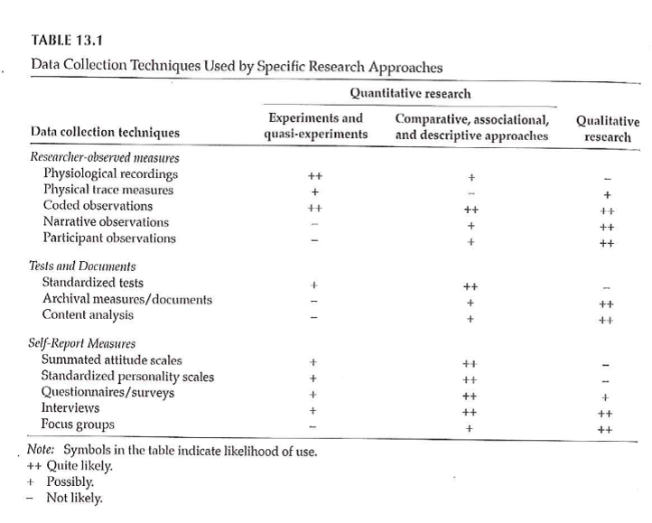
Data Collection Techniques
Notes:
Table 13.1 is useful in terms of the various things that we will touch on. It classifies by the two types of quantitative research and by qualitative research. Organized by the potential amount of patient filtering. The ones at the top should have less participant filtering. Also note that the symbols are not hard and fast rules, but represent the likelihood.

Slide 44
Data Collection Techniques
Standardized vs Investigator-Developed Instruments
Development and Use
Evidence to support investigator-developed instruments
Notes:
There is a lot of work in the development of standardized instruments, manual and documentaiton, normative values, apply to a broad area. Investigator developed instruments focus on a more specialized area, but you still need to supply information on validity and reliability.
Whenever possible use instruments already in use. You can find these in places like PROQOLID. This originally started as quality of life measurements, but has expanded. NIH compilation of patient reported outcome measures (PROMIS). NIH wants the research community to use common measures to allow easier compilation of studies in a meta-analysis.

Slide 45
Data Collection Techniques
Researcher-Observed Measures
Naturalness of the setting
Observer “participation”
Amount of detail
Breadth of coverage
Notes:
The focus is on direct observation. The more natural the setting, the less control you have. This might hurt the internal validity of the study. It is a trade-off.
How much does the observer participate. In interviews and focus groups, there is a very clear high level of participation. On the other extreme, observation in public places might not have any knowledge of their participation. In the middle are studies where participants know they are being observed, but this knowledge may fade into the background.

Slide 46
Data Collection Techniques
Tests and Documents
Standardized tests
Norm referenced test
Criterion referenced test
Achievement tests
Performance and Authentic assessments
Aptitude tests
Documents
Content analysis
Notes:
Norm scores allow you to compare to other scores (historical comparisons). These tests are very objective, but there is some subjectivity, perhaps, in their interpretation.
Measuring actual performance (ecologic validity). Tries to be very relevant to the setting.
Use existing documents. Existing records might have a higher level of accuracy but there is no gauarantee. Time is shorter because the documents already exist. Data extraction takes time. Do you need consent from the people associated with these documents.
Data abstraction is tedious, but the newer systems like i2b2 allow you to get the information more directly.
Content analysis is a more qualitative review. It gives you a lot of valuable information that a quantitative approach might miss.

Slide 47
Data Collection Techniques
Self-Report Measures
Standardized Personality Inventories
Attitudes / Beliefs scales
Likert scale
Semantic differential scale
Questionnaires
How delivered / administered
Item types
Interviews
Focus groups
Notes:
Personality inventories: the validity is dependent on an individual’s self-awareness.
Attitudes and beliefs done for a variety of purposes. A “representative sample of all possible opinions or attitudes about a particularl subject.” That’s why measurement experts cringe when you ask a single question. You need a multiple set of items to get at how people feel.
The Likert scale is very popular. You may not see the semantic difference scale, but examples will follow.
Delivery by mail or Internet. There are pros and cons to all formats. Item types could include open ended, partial (responses plus other), and close ended responses.

Slide 48
Descriptive Research
Surveys
Methods
Interview
Questionnaires
Design of surveys
Research question
Review of existing instruments
Process of designing survey
Notes:
Interview allows you to probe for comments. Video as well as audio is now available. It takes time and training. Concerns about anonymity with an interview.
Questionnaires are self-administered. Return rates are a concern. When sent out blindly, you can get low return rates, which hurts the generalizability of the study. There is potential for misunderstanding and people may get into a routine response and not provide as good quality of response.
Design the survey to address your research question. Thing about the pieces and the order.

Slide 49
Data Collection Techniques
Surveys
Survey question format –
Open ended
Close ended
Wording of questions
Scales
Scale of measurement
Response options
Notes:
Even as simple as something like age, you can ask it in an open ended format that allows you to categorize any way you like or even to forgo categorization.
Wording is important. Simplicity and reading level. Use standardized scales whenever you can.
Double-barreled questions. [[Ask option about supervisors and managers]]
How many times questions, think about the time frame (over the past 24 hours, past week, past month). Shorter time frames better recall, but subject to more external variations.
Building a level of trust. Don’t ask people to admit to “bad behavior”. Think of it from the perspective of the person providing the information.
[[Income: actual versus categories]]

Slide 50
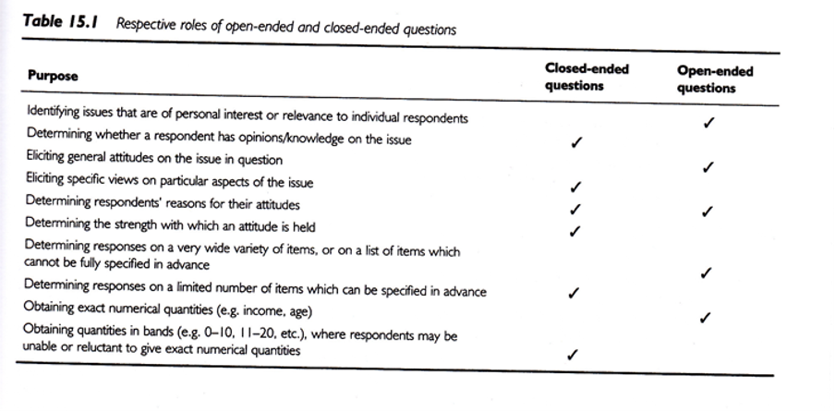
Data Collection Techniques
Notes:
Open ended vs Close ended
Respective roles of open or close ended format. This is a nice guide.
.footnote[Sim & Wright, 2002]

Slide 51
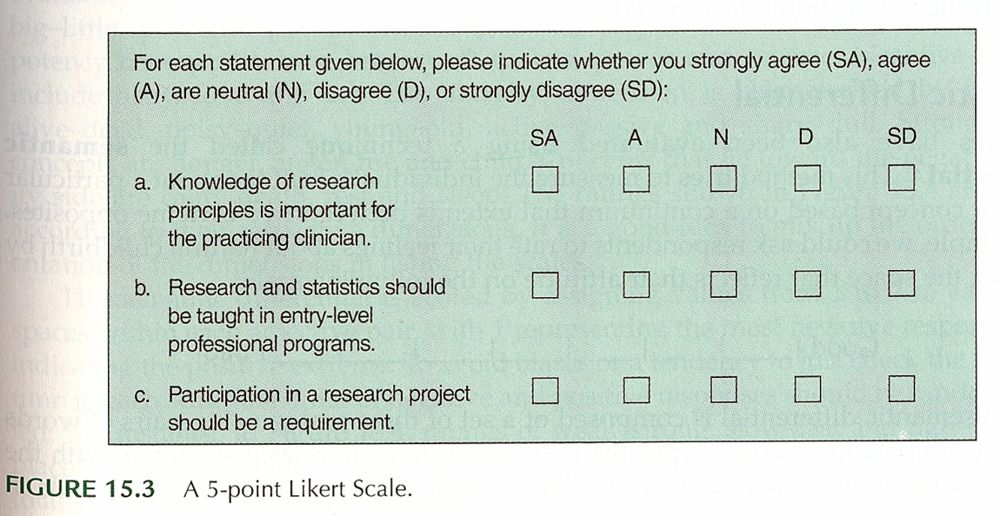
Data Collection Techniques
Notes:
Surveys – Response Options
Likert
.footnote[Portney & Watkins, 2009]
Example of five points (SD, D, N, A, SA)

Slide 52
Data Collection Techniques
..
Notes:
Everyone uses the term Likert with a hard-i, but the persons who developed this scale used a soft-i.
All items contributing to a total.
Some debate about the number of categories. Odd versus even. Even forces an opinion. Also a debate over a large versus a small number of items.
Do you want to reverse code some items. It could help keep the participants alert and thingking This may end up confusing. [[13 questions, but question 8, first question on the bakc page, was the only reverse coding.]]
Surveys – Response Options
Likert
.footnote[Sim & Wright, 2002]
Figure 15.8 is a different version of a five point scale.
Commercial plug for REDCap. Entry on a tablet. Coding is done on the back-end.

Slide 53
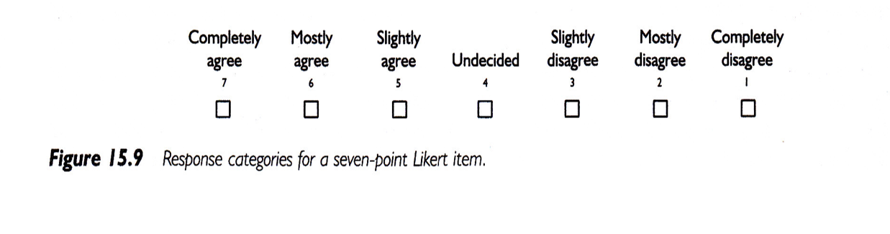
Data Collection Techniques
Notes:
Surveys – Response Options
Likert
.footnote[Sim & Wright, 2002]
Figure 15.9 shows a seven point response.
IRB insistence on a “Prefer Not to Answer” response. Contrast this to a “Neutral” option.

Slide 54
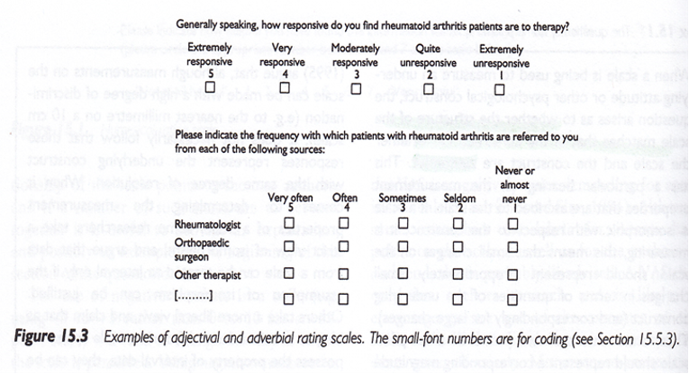
Data Collection Techniques
Notes:
Surveys – Response Options
.footnote[Sim & Wright, 2002]
Figure 15.3
These scales seem backwards to Mary. You don’t necessarily need to include the numbers are on the form. They can be added on the back end.

Slide 55
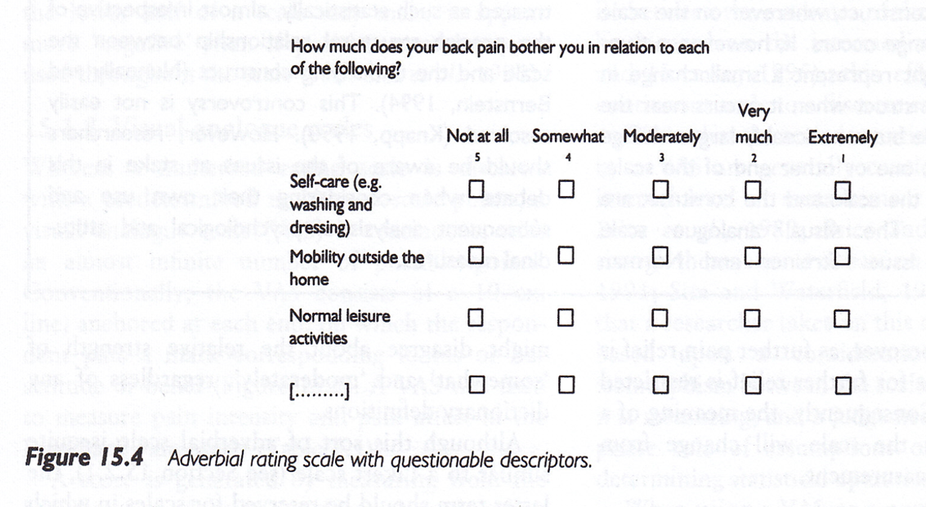
Data Collection Techniques
Notes:
Surveys – Response Options
Figure 15.4, Sim & Wright, 2002.
Not at all, somewhat, moderately, very much, extremely.
Note that the largest number is associated with “not at all”.
Double check that everyone agrees that somewhat is less than moderate, very much is less than extremely.

Slide 56
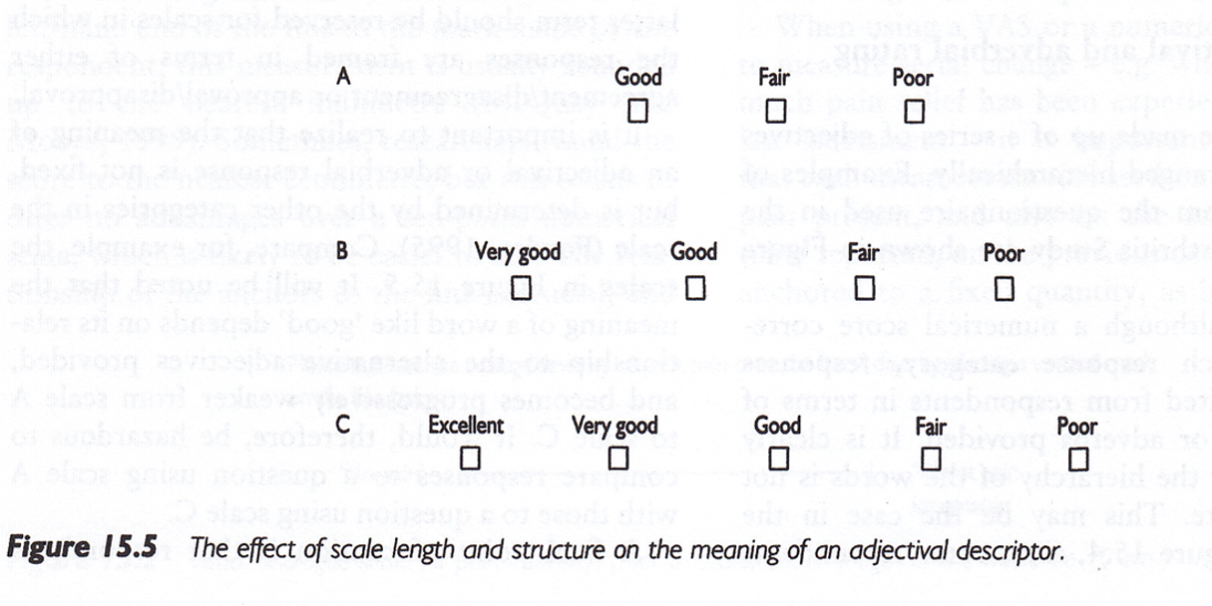
Data Collection Techniques
Notes:
Surveys – Response Options
Figure 15.5. [Sim & Wright, 2002]
Good, Fair, Poor is a three point scale. Add Very good for a four point scale. Add Excellent to get a five point scale.

Slide 57
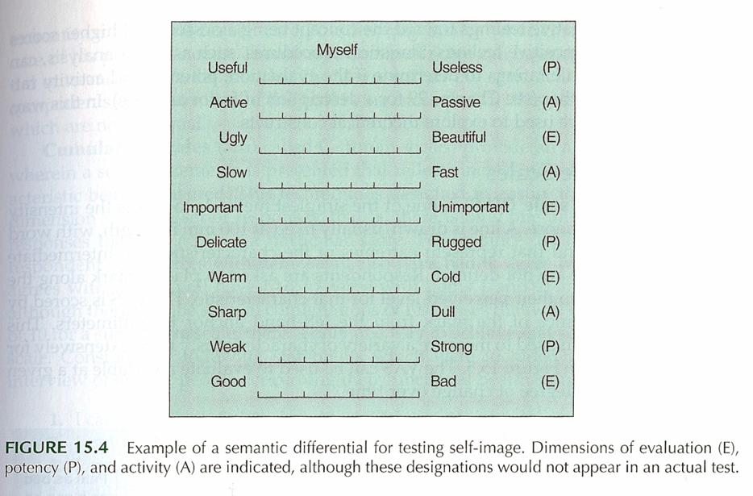
Data Collection Techniques
Notes:
Surveys – Response Options
Semantic Differential
Figure 15.4 [Portney & Watkins, 2009]
This is an example of a semantic differential. Seven point scale. Only label the extremes. Notice the reverse scaling of some items.

Slide 58
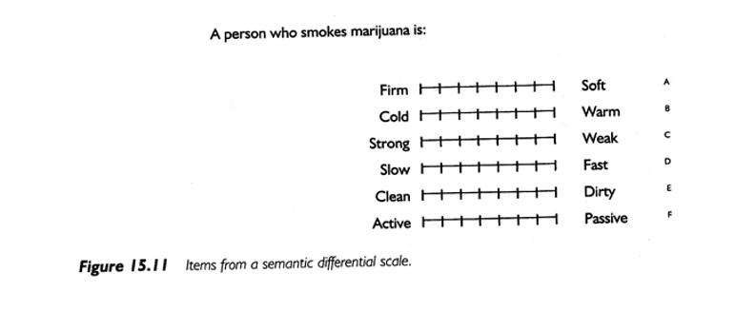
Data Collection Techniques
Notes:
Surveys – Response Options
Semantic Differential
Figure 15.11 [Portney & Watkins, 2009]
A second example of a semantic differential scale.

Slide 59
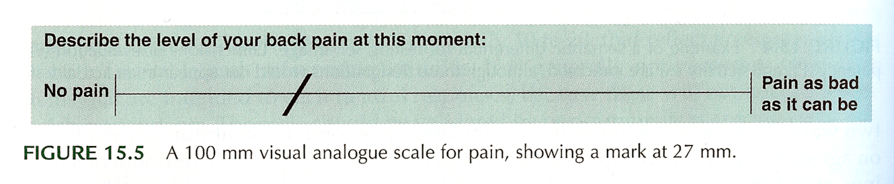
Data Collection Techniques
Notes:
Surveys – Response Options
Visual Analogue Scale (VAS)
Figure 15.5. [Portney & Watkins, 2009]
Commonly used for pain. Usually the line is 100 mm long. Gives you a number from 0 to 100, which allows you to treat this as a continuous variable.
Anchors at each extreme.
How do you handle a check mark.
This is a very labor intensive data entry task.
Note that the photocopy process can change the length of the scale (102 mm versus 100 mm).

Slide 60
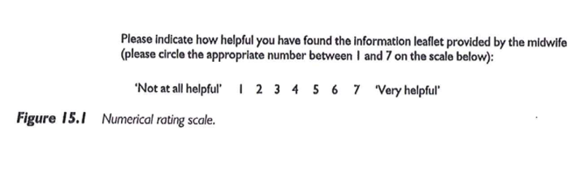
Data Collection Techniques
Notes:
Surveys – Response Options
Numerical Rating Scale
Figure 15.1 [Sim & Wright, 2002]
This scale has 7 numbers with anchors at each end.

Slide 61
Descriptive Research
Surveys
Pit-falls and words of caution
How responses are recorded
Wording of items
Literacy level
“ Loaded ” wording
Complexity of items
More than 1 “ unit ” in a single item
Clearly stated terms
Notes:
There are ways of checking the reading level of the survey. Good instructions. Branching (if “no” skip) patterns need to be laid out very clearly.

Slide 62
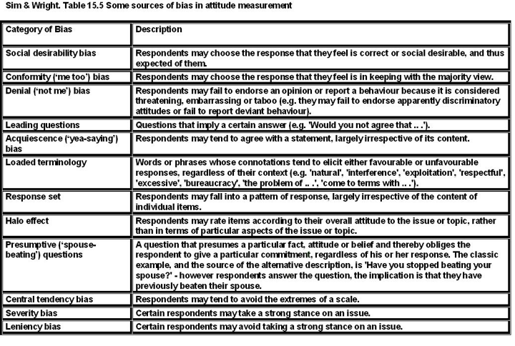
Data Collection Techniques
Notes:
Sim and Wright. Sources of bias in attitude measurement.
Social desirability, conformity, denial, acquiescence.
Leading questions, loaded terminology, presumptive (wife-beating)
Response set (stuck on the same value), or tendency to extremes.
Example of “push polling.”
“Any other comments?” http://www.biomedcentral.com/1471-2288/4/25.
http://www.pmean.com/04/DesigningQuestionnaire.html

Slide 63
Data Collection Techniques
Surveys – Example
Using a scale of 0 to 100, please indicate the percentage of time you take all the doses of your medicine?
… take all the pills in each of your doses?
… take all doses on the prescribed schedule?
… follow all special instructions …
… make sure you refill all of your medications on time?
Notes:
Medical history interview. Anti-retroviral medication, but some had no history yet, so used adherence in general. This gets tricky with multiple medications.
There’s an issue that came up when using this study, which will be discussed in the discussion board. Answer these questions yourself, and how you based your response to the second through fourth items.

Slide 64
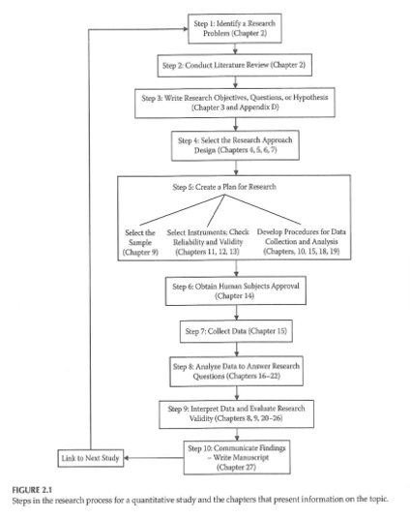
Data Collection & Coding
Notes:
Figure 2.1 from your book. This is back from Chapter 2, and keep this in mind when you are designing your data collection.

Slide 65
Data Collection & Coding
Initial Steps
Planning the study
Pilot testing
Data collection
Check for completeness if possible
Notes:
How things are working, where there is lack of clarity, how long does it take, where the systems don’t work.
Make sure that your extraction process is complete as possible for secondary data. For prospective surveys, flip through a survey upside down to see if items are all filled in. Hope that you haven’t missed a page. Electronic collection can force someone to respond before they answer the next question.
[[Ethically can’t force someone to complete a questionnaire.]]
How do you handle multiple responses.
Code the maximal detail of variables like age so you can collapse as you see fit. Make sure that you code missing or ambiguous responses consistently.
REDCap is great!
[[Double entry coding]]

Slide 66
Data Collection & Coding
Data Coding, Entry, and Checking
Guidelines
Mutually exclusive levels
Code for maximum information
Record is as complete as possible
Consistency
Data entry form
Checking entry

Slide 67
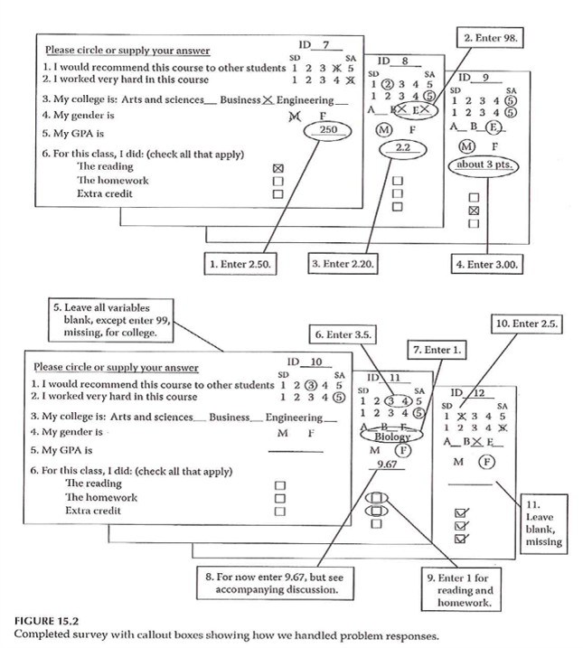
Data Collection & Coding
Notes:
Figure 15.2. Completed survey with callout boxes showing how we handled problem responses.

Slide 68
Data Collection & Coding
Data Entry into Statistical Program
Layout of data sheet
Variable names
Labeling
Variables
Values
Codebook / documentation
Notes:
[[See Intro to SAS/R material]]
By thinking about the backend process, you can sometimes fix things before you collect the data.
Mary uses Excel for documentation, but never for analysis, rarely for data entry.
Summarizes factor analysis, Cronbach’s alpha. Note whether better to have high score or better to have low score.
[[EUSpRIG site]]

Slide 69
Data Collection & Coding
Data Summation
Descriptive information
Categorical variables
Continuous variables
Data checking – part 2
Notes:
Look for inconsistent values, outliers, invalid values.
Note that certain responses on one question might lead to limits on the responses to other questions. Example, ever smoked? versus How many years?

Slide 70
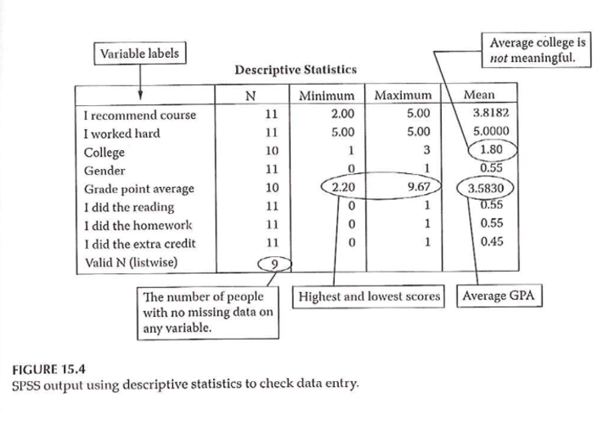
Data Collection & Coding
Notes:
Figure 15.4 shows SPSS output using descriptive statisticis to check data entry. Example of Likert scale where everyone responded 5. Note the number of responses/missing responses.
Hopefully, you’ve done such a good job planning that these issues don’t arise after the data is collected. [[Ha!]]

Slide 71
Measurement dichotomies
Standardized versus investigator developed measures
Researcher evaluation versus patient report
Field measurements versus laboratory measurements
Ecological validity
Standardized test

Slide 72
Researcher evaluations
Norm referenced tests
Criterion referenced tests
Achievement tests
Performance assessment
Authentic assessment
Aptitude tests
Projective technique
Documents

Slide 73
Self report
Standardized personality inventories
Paper and pencil
Machine scored

Slide 74
Questionnaires
Definitions
Survey
Questionnaire
Interview

Slide 75
Delivery
Remote administration
Mail
Internet (Survey Monkey)
Direct administration

Slide 76
Structure
Open ended
Partially open ended
Unordered closed response
Ordered closed response
Interviews
Telephone
Face-to-face
Focus groups

Slide 77
Analysis of Qualitative Data
http://blog.pmean.com/semi-structured-interviews/
Positivism versus constructivism, revisited
https://www.sagepub.com/sites/default/files/upm-binaries/29985_Chapter1.pdf
http://blog.pmean.com/recommended-philosophy-news-network-postmodernism-special-report/
Tools: semi-structured interviews, participant observation, photo elicitation(?), mapping exercises(?), web and space design workshops(?), archival records, physical artifacts,
Typically, a one-hour interview requires a minimum of three to four hours (or more) of analysis.
Involve the participants in the process, especially for narrative research.

Slide 78
Analysis of Qualitative Data
Inductive process –
Start with the specific (raw data / transcript)
Develop a theoretical framework from the data
Conceptual categories emerge from the data

Slide 79
Analysis of Qualitative Data
Start the study with a research question
This may provide a potential starting point for analyzing text
If you do this, DO NOT let it prevent you from seeing what is in the text
Steps
From raw data to theory building
“ Iterative ” process
e.g. , as you are developing categories, check them back against the raw data – do they continue to reflect the original data?
Notes:
Keep alert and look for things that come out in the material that you were not anticipating. As your categories, go back and compare them against the raw data. Make sure that you allow the data to guide you. Often coding from transcripts. But it is also good to have access to the original recordings. Sometimes there is a doubt about what some was saying (joking or sarcasm). Look for tone of voice and non-verbal cues.
Content analysis is a generic term, but you can look at things like ad messages in magazines that appeal to young adults.
Thematic analysis is looking for patterns.

Slide 80
Analysis of Qualitative Data
Analysis process –
Given research question, may have some idea of a general conceptual structure; serve only as a starting point
Usually work from transcripts
If possible, refer back to audio recordings when needed
Qualitative form of analysis
Content analysis – analysis of the content of communication
Thematic analysis – identifying patterns or themes in the data
Notes:
Break up the text into “bits” that represent specific thoughts. Open coding lots of themes. Axial coding looks at the relationships between themes, builds a superstructure of ideas.

Slide 81
Analysis of Qualitative Data
Category Formation – assign sections (data bits) to analytical categories/themes “coding”
Summarizing the data by identifying similarities and differences / commonalities and contrasts
Categories:
More manageable units of information
“open coding”
Descriptive – Concrete
Interpretive – Abstract
Relational
Cross-reference categories back to text
Makes it easier to revise coding as needed
Notes:
Software allows you to go back and forth between themes and the original text. Cross-referencing is important. Find examples easily. It helps provide validity checks. Does someone agree with your categorization.
Categories need to be faithful to the data. This is internal validity. But you need to place this in a broader understanding.
You need to be careful about trying to quantify this too much. Keep in mind that just because someone talks about something a lot does not mean that this is the most important thing to them. The most important thing might be something that people are uncomfortable talking about.

Slide 82
Analysis of Qualitative Data
Category Formation
Faithful to the data – “internal” aspect
Meaningful to other categories – “external” aspect
Balance
Generality vs Specificity
Inclusivity vs Exclusivity
Number of times idea mentioned does NOT necessarily reflect importance

Slide 83
Analysis of Qualitative Data
Labeling / Revising Categories
Member-generated – “ first-order ” account
Observer-generated – “ second-order ” account
Labels are provisional; may be revised
Iteration – move back and forth between raw data and labeled categories
“ Zoom in ” vs “ Wide angle ” view of the coding
Revision – may end up dividing or combining categories
May establish criteria for category coding
Notes:
Phrasing of the person versus observations generated by the researcher. Labels should be considered as provisional as you work with more complete information. It is an iterative process. Go back to original data. You’re looking at the specific of what’s been told versus a broader understanding.
Establishing the criteria may depend on how many people are doing the coding. If you don’t have a pre-existing structure, the coding may evolve and may involve 100% review (both raters review everything and resolve discrepancy). Then a third person does an audit.

Slide 84
Analysis of Qualitative Data
Saturation – the point at which you are not gaining any new insight, no new categories being identified, no new relationships being defined
Don’t need any additional analysis
Don’t need any additional data collection (if collection & analysis done in parallel)
Determinant – nature of the information being collection – NOT amount of information
Keeping notes – of the coding/analysis process
Help identify categories/relationships
Help if “stuck”
Document analysis process
Notes:
Saturation is a way to assess your sample size. Have you gotten a representative amount of data.
Really important to keep notes of the coding and analysis process, so you can check your work. Allows you to do qualirty checks on the process.

Slide 85
Analysis of Qualitative Data
Role of Judgment
Balancing act –
Level of creativity by coder to identify categories/relationships
Must reflect the informants thoughts
Audit of the coding by an independent person can check for the match between the coding and the source information
Low-inference descriptors
Look for “negative cases”
Notes:
You develop a framework, but that framework must always represent what the subjects have said.
Low inference descriptors are those things involving just the basic words or text.

Slide 86
Analysis of Qualitative Data
Quantifying Information
Pros & Cons
When quantifying might be of value
Simple frequency of occurrence does NOT necessarily reflect importance
Notes:
This was mentioned earlier.

Slide 87
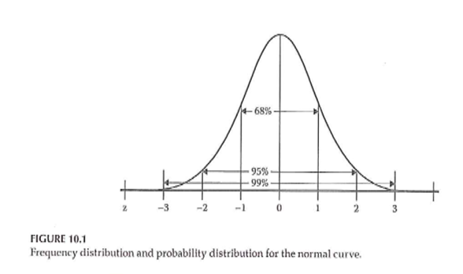
Descriptive Statistics
Notes:
Figure 10.1 shows the standard bell shaped curve.

Slide 88
Descriptive Statistics
Descriptive graphs
How to look at your data
Options for viewing your data
Frequency polygons
Histograms
Bar charts
Notes:
Even for a qualitative study, you’ll still want to describe characteristics of your sample.
For a fancier inferential analysis, you still should start with a descriptive analysis.

Slide 89
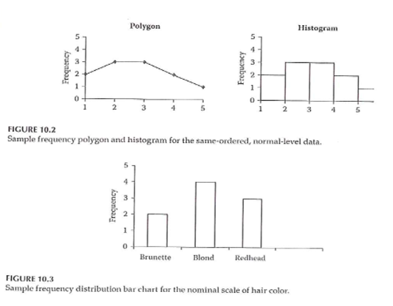
Descriptive Statistics
Notes:
Figures 10.2 and 10.3.
Frequency polygon has a line connecting values and implicitly represents a normal distribution.

Slide 90
Descriptive Statistics
Measures of central tendency
Mean
Median
Mode
Notes:
These terms should already be familiar to you. The mean is the best choice for approximately normal distribution. The median is better for non-normal continuous variables and ordinal variables.

Slide 91
Descriptive Statistics
Measures of variability
Range
Standard deviation
Interquartile range
How many categories
Notes:
The standard deviation is considered a poor measure of variability for a non-normal population. The interquartile is the difference between the 75th percentile and the 25th percentile. Define the 25th percentile as the value so that approximately 25% of the values are smaller and 75% are larger.

Slide 92
Descriptive Statistics
Measures of association between 2 variables
Correlation
Pearson
Spearman
Cross-tabulation
Scatterplot
Notes:
A correlation is a value between -1 and +1. There are two versions. Use Spearman for non-normal or ordinal variables.
Cross-tabulation is best for nominal and ordinal variables.

Slide 93
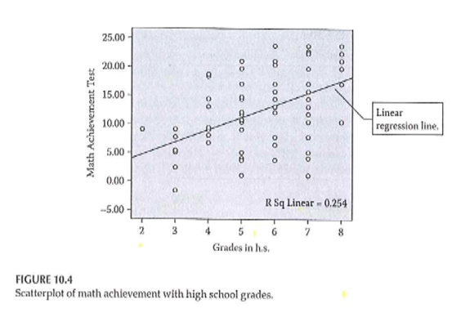
Descriptive Statistics
Notes:
Figure 10.4 shows the relationship between grade level and performance on a math achievement test. It shows a trend line and an R-squared value.
Note that this is an association but not necessarily a causal relationship. Knowledge of one variable helps you predict the other.

Slide 94
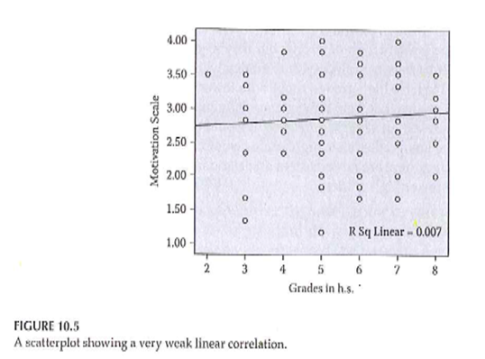
Descriptive Statistics
Notes:
Figure 10.5 shows a much weaker relationship between grade level and motivation scale. The trend line is flat and the R-squared value is small.

Slide 95
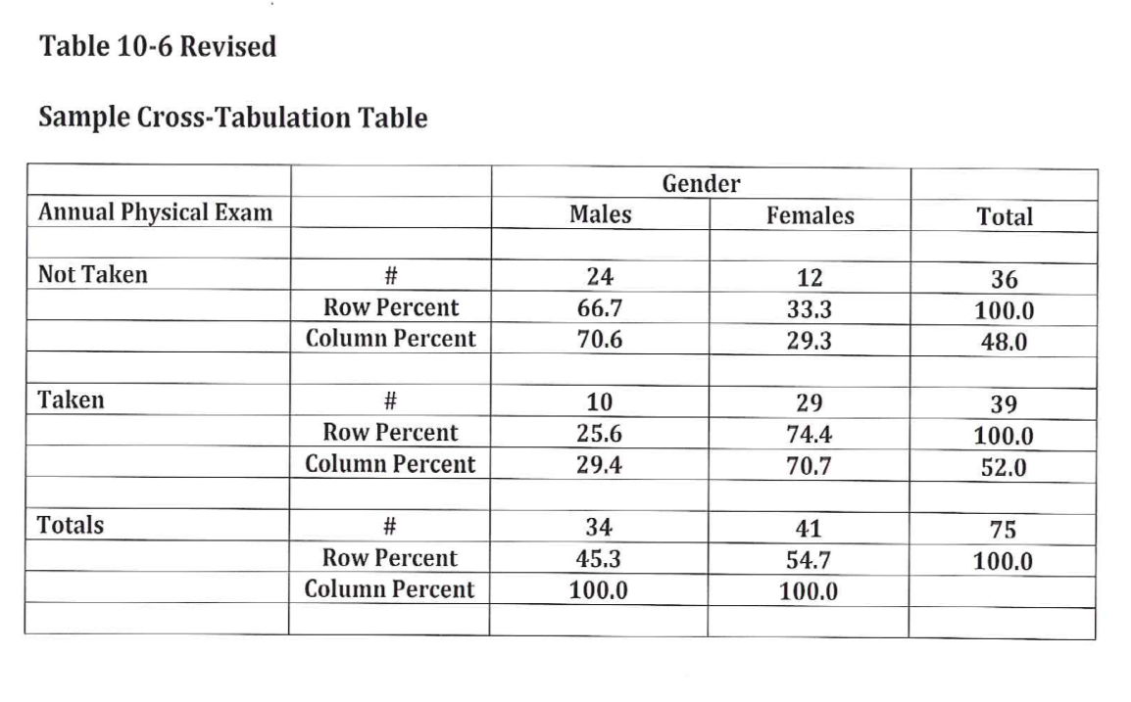
Descriptive Statistics
Notes:
Table 10.6 shows a cross-tabulation. Mary revised this to include row and column percentages. Orient towards the row totals or the column totals. Row percentages add up to 100% within each row and column percentages add up to 100% within each row.
You might compute both row and column percentages, but only include one in your final table.

Slide 96
Descriptive Statistics
Properties of the normal curve
Unimodal
Mean, median, and mode are equal
Symmetric curve (skew)
Range is infinite
Shape – not too peaked or flat (kurtosis)
Notes:
This is not a Statistics class, but is intended to help you decide how to choose analyses for your research plan.
There are five properties. Unimodal, symmetric (no skewness), infinite range, peakedness or flatness tells you information about the tendency to produce outliers.
[[Talk about range restrictions.]]

Slide 97

Descriptive Statistics
Notes:
Figure 10.1 (normal curve) again.

Slide 98
Descriptive Statistics
Standard normal curve
Definition
How to compute
Effect size
Notes:
Set the mean to zero and a standard deviation of one. The standard normal curve is useful for effect size calculations and power analysis.

Slide 99
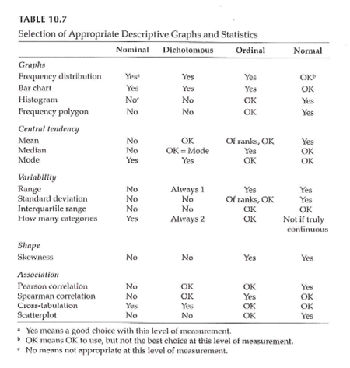
Measurement & Descriptive Statistics
Notes:
Table 10.7. This is a great table that tells you what graphical and numeric summaries are appropriate for what types of data. This doesn’t address the statistical tests (inferential analyses).

Slide 100
Making Inferences - NHST
Populations versus Samples
Use inferential statistics
Sample statistics (M, SD) <U+F0E8>
Population parameters (mu, sigma)
Null Hypothesis Significance Testing (NHST)
Null hypothesis (H 0 )
Alternative hypothesis (H 1 )
AKA research hypothesis
Directional
Non-directional
Notes:
We are talking about data analysis and interpretation. Planning. Some of this will be familiar to you. This is not a full statistical coverage of the topic.
Take the data from the sample and make inferences about the population. The sample is a subset. Inferential statistics is the process by which you infer information about the population.
NHST is the traditional way that a huge amount of research relies on.
Null hypothesis is no difference or no relationship. The alternative is often called the research hypothesis.

Slide 101
Making Inferences - NHST
NHST – Goal of research –
Reject the H 0 in favor of H 1
“Reject” the null hypothesis
Practically – “reject” means difference / relationship greater than just random variability
Alternative hypothesis –
3 versions
Non-directional
Directional positive
Directional negative
Notes:
Does the data allow us to reject the null hypothesis. Rejecting means the difference or relationship is greater than what you’d expect due to sampling error.
[[Directional only for two group comparisons or bivariate relationships]]
never talk about proving the null hypothesis. A large p-value does not mean that you proved the null hypothesis. There might be sources of error that lead to failure to reject the null hypothesis.

Slide 102
Making Inferences - NHST
Directional vs Non-directional H 1
Comparing treatment to control
Comparing different treatments
Choosing directional vs non-directional
Basis for choice
Consequences
Statistical analysis
Interpretation
Notes:
Directional is more likely when comparing a treatment to a control [[placebo]]. When comparing two different treatments, you would have to use a non-directional hypothesis.
Is there existing evidence to support a directional hypothesis.
If you use a directional hypothesis, and you get an extreme result in the opposite direction, you can’t claim statistical significance.
Some people think that directional hypotheses are “cheating”.

Slide 103
Making Inferences - NHST
Sampling review
Target / theoretical population
Accessible population
Sample
Inference from the study sample to the population
Notes:
So how well does your sample reflect the population?

Slide 104
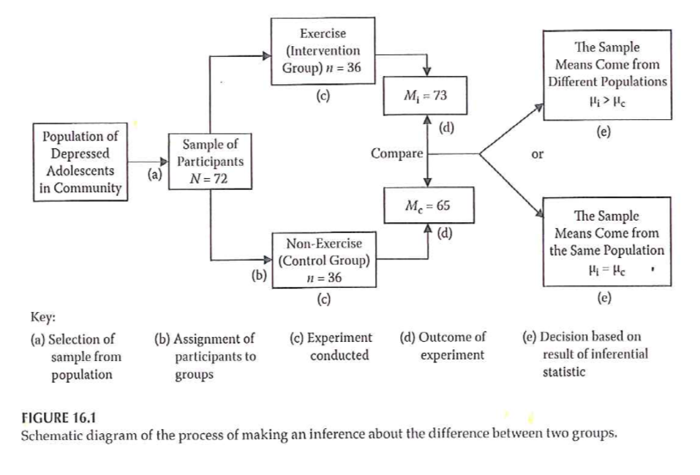
Making Inferences - NHST
Notes:
Example
Figure 16.1 from your book.
Flow chart of selecting from a population, randomizing to two groups, and then comparing the results in each group, and choosing between two hypotheses.

Slide 105
Making Inferences - NHST
Accessible population -> Sample
Random assignment to groups
Conduct study and collect data
Conduct statistical analysis
Intervention group: mean = 73
Control group: mean = 65
Notes:
[[This is a re-iteration of Figure 16.1]]
From your basic Statistics class, you may recognize that this setting would require a two-sample t-test.
[[Knowing which statistic to use in what setting is one of the most difficult tasks that you will encounter.]]

Slide 106
Making Inferences - NHST
Significant difference or not?
Inferential statistics – allow you to determine this
Reject the null ->
The observed difference is highly unlikely if the null hypothesis is actually true
Fail to reject the null ->
We can not say that the observed difference is highly unlikely
Do NOT “accept” the null hypothesis
Notes:
[[If a particular sample result is unlikely under the null hypothesis, this causes you to question the null hypothesis.]]
Reasons why you failed to reject the null hypothesis. A poorly implemented intervention, failure to use valid and reliabile measures, quality problems during the study.
Why never say that we accept the null.

Slide 107
Making Inferences - NHST
( Portney & Watkins, 2009)
Notes:
This is a table of possible outcomes H0 true, H0 false versus reject H0, accept H0.
Define power as the probability of rejecting the null hypotheis when the alternative hypothesis is true. [[Since the ]]

Slide 108
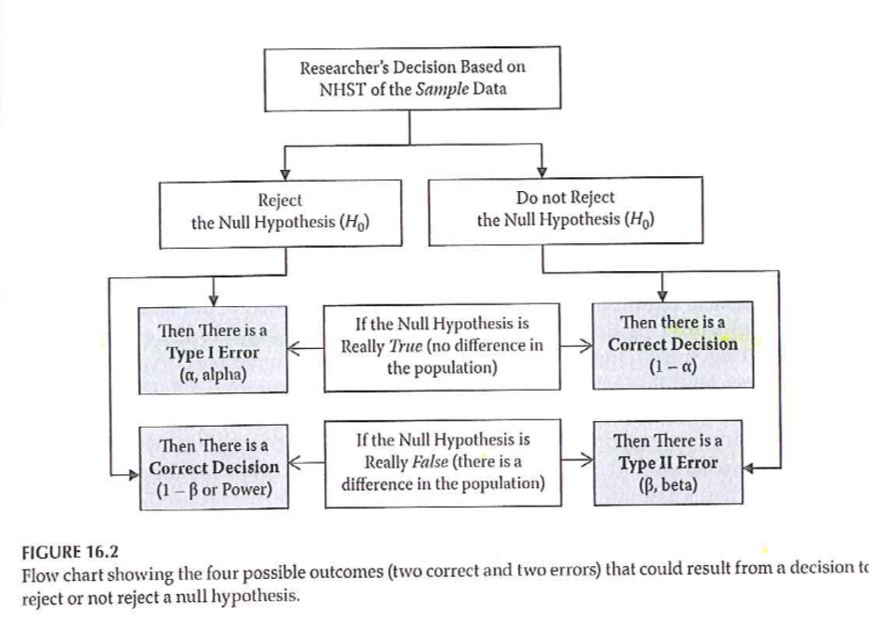
Making Inferences - NHST
Notes:
Statistical testing – possible outcomes
Figure 16.2 provides a different way of displaying Type I and Type II errors in a two by two table.

Slide 109
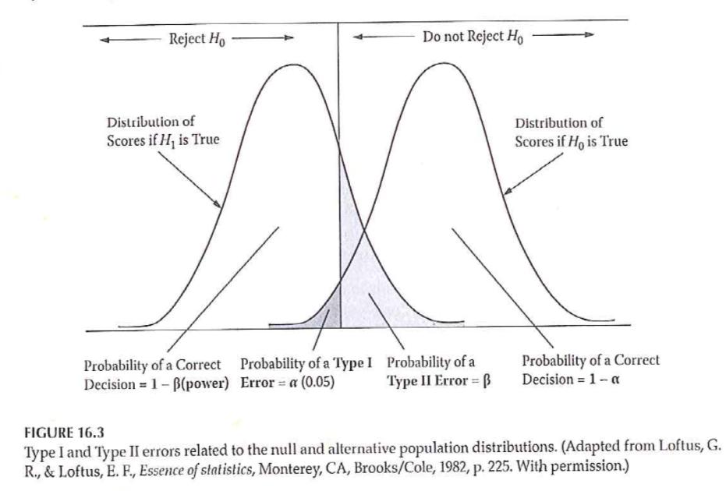
Making Inferences - NHST
Notes:
Statistical testing – possible outcomes
Two normal distributions and bell shaped curves.
Figure 16.3 from your book. Directional negative hypothesis. Example an intervention that results in a reduction in symptoms/pain.

Slide 110
Making Inferences - NHST
Statistical testing
Fig 16.3 – Directional negative
Example – hypothesize that intervention will result in reduction of symptoms
If you made a directional positive alternative hypothesis …. ?
Notes:
[[This is a rehash of Figure 16.3.]]

Slide 111
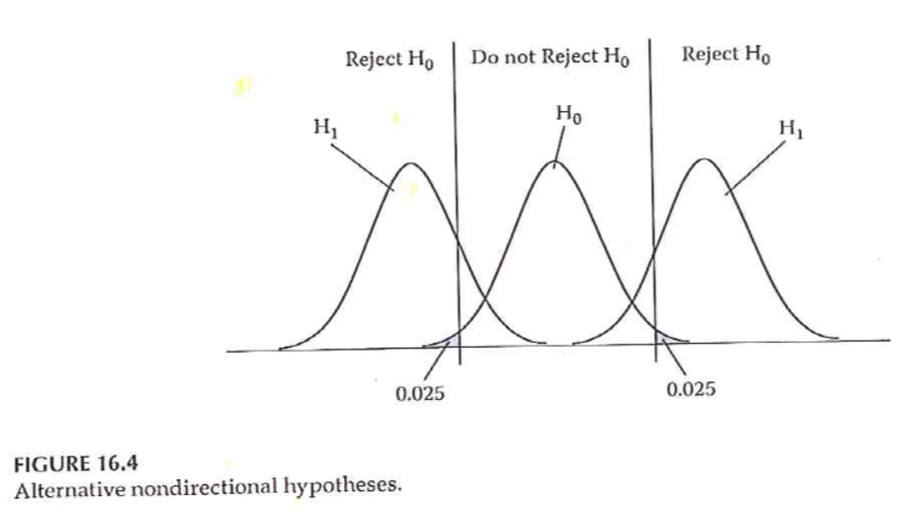
Making Inferences - NHST
Notes:
Statistical testing
Fig 16.4 – Non-directional

Slide 112
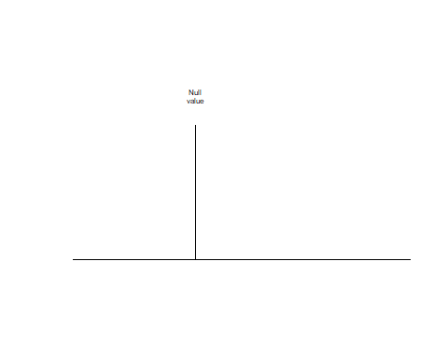
Null value

Slide 113
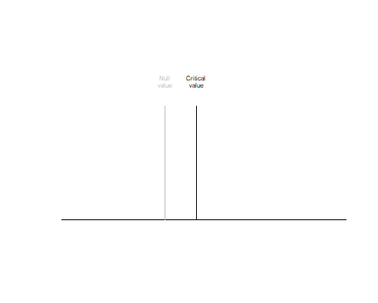
Critical value

Slide 114
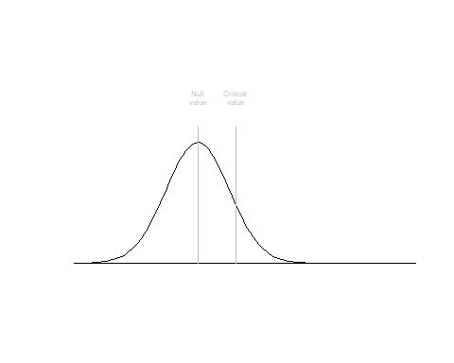
Alpha level

Slide 115
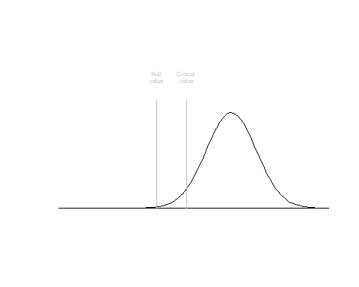

Slide 116
Power Analysis
Probability of rejecting a false H 0
This is a GOOD thing!
Want to maximize this (within reasonable limits!)
What is power analysis
“… the probability that his investigation would lead to statistically significant results.”

Slide 117
Power Analysis
( Portney & Watkins, 2009)

Slide 118
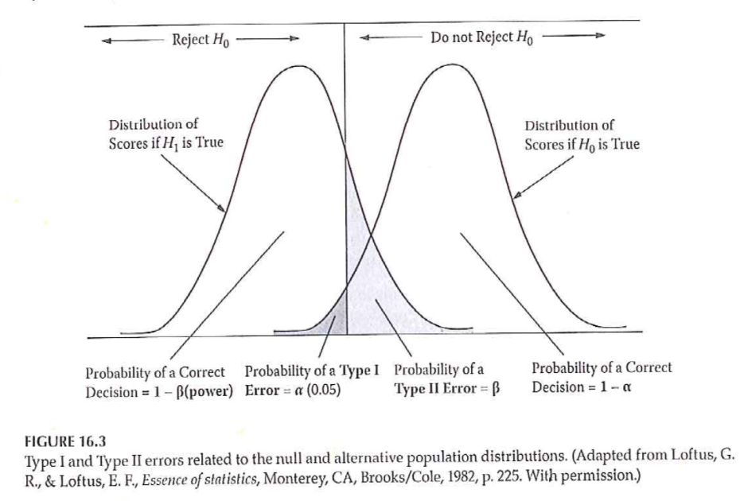
Power Analysis
Notes:
Power of a study – probability of rejecting a false null hypothesis

Slide 119
Power Analysis
Statistical power analysis concepts (Cohen)
Significance criterion – alpha
Power – desired level
Sample size
Effect size
Power analysis method depends on research design

Slide 120
Power Analysis
Performing a power analysis when planning a study
What is the study design?
What do you already know about the measure you are interested in?
What significance level to you want to use for hypothesis testing?
What level of power do you want to achieve?

Slide 121
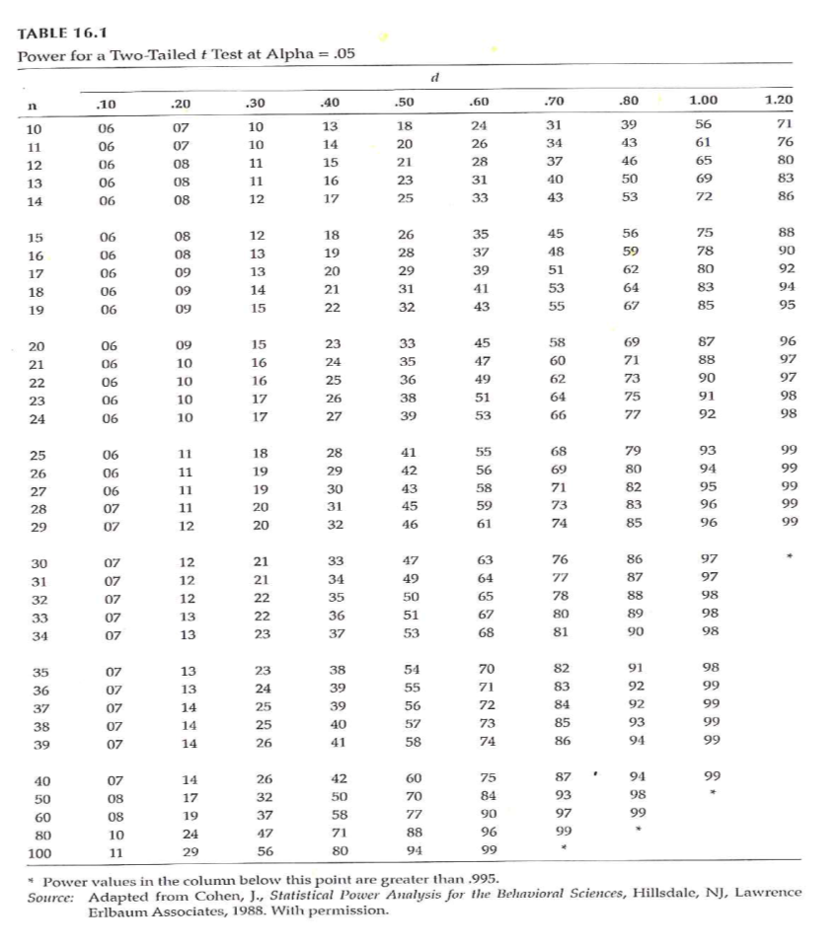
Power Analysis
Notes:
Determining power (Fig 16.1)

Slide 122
Power Analysis
Increasing power –
Alpha level
Formulation of hypothesis
Decrease variability / increase precision
Groups
Outcome measure(s)
Increase sample size

Slide 123
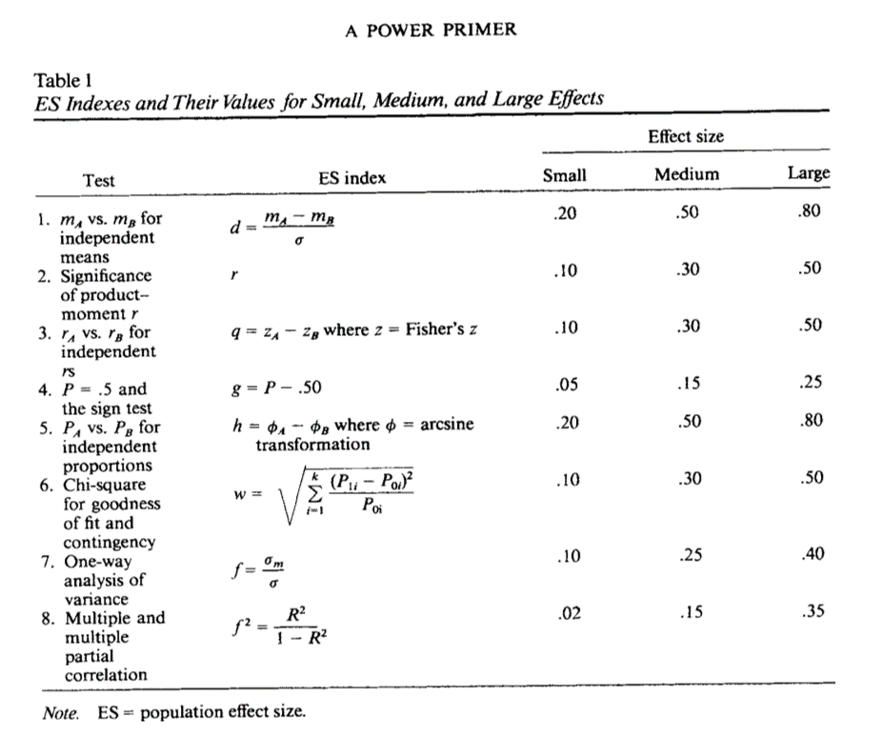
Power Analysis

Slide 124
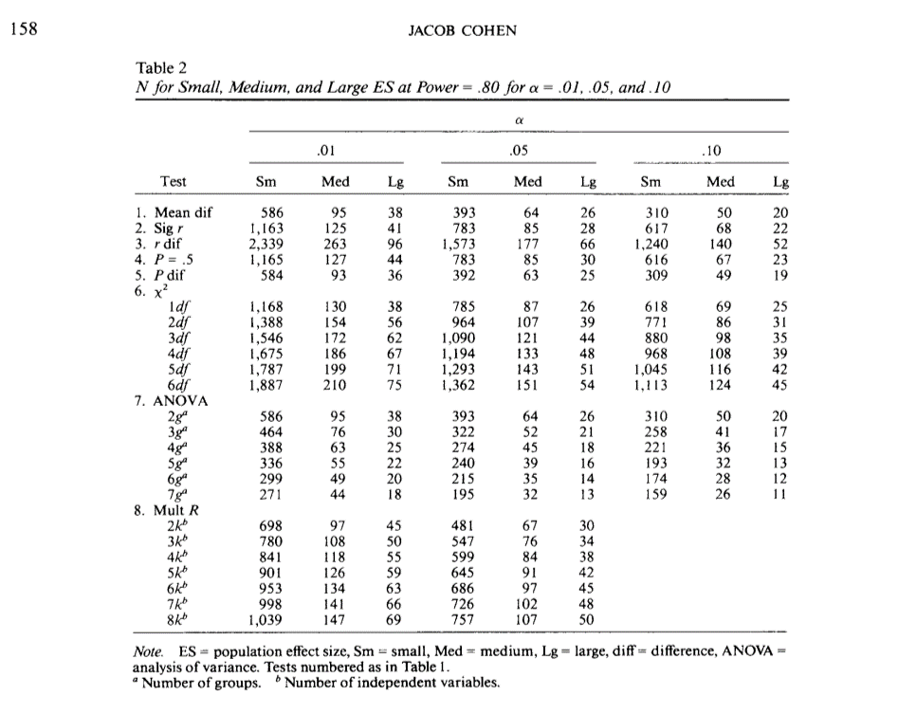
Power Analysis

Slide 125
Problems with NHST
Knowledge based on outcome of single study
Interpretation of statistical significance
Complications
H 0 is rarely true – in a strict sense
Too large of a sample size – hard NOT to get statistical significance
Significance testing as a dichotomous decision
Interpretation of changes in the p value
Statistical significant versus clinical/ substative meaningfulness
Notes:
There is always a level of uncertainty associated with a single study.
[[ASA statement on p-values]]
[[Sackett article. http://www.cmaj.ca/content/165/9/1226.short or http://blog.pmean.com/physiological-statistics/ ]]
[[ Example of PiFace http://blog.pmean.com/simple-sample-size/ ]]
[[ Range of clinical indifference http://www.pmean.com/04/confidence.html ]]
[[p-values with lots of zeros, doesn’t make up for biases in the study.]]

Slide 126
Improving NHST
Propose specific alternative hypotheses
Use a random sample if possible
Use an outcome variable that has good reliability and validity
Have a good idea of the level of difference that will be clinically important

Slide 127
Making Inferences - EBA
EBA – Evidence-Based Approach
Reliability of findings
Accumulation of evidence
Premise – “… a single study is not sufficient to use as evidence to substantiate a hypothesis or theory.”
Methods
Confidence intervals
Effect sizes
Meta-analysis

Slide 128
Making Inferences - EBA
Confidence Intervals (CI)
Range of scores that should contain the true population score
CI <U+F0E8> An interval around the point estimate
CI <U+F0E8> “… range of the dependent variable scores that should contain the true population difference between means .”
CI computed using sample mean and standard deviation

Slide 129
Making Inferences - EBA
Interpretation of CI –
95% CI most common
95% CI – with infinite studies and computed CI, the true population difference would be found within 95% of the intervals
NOT – .95 probability that true population difference is within the CI computed from our single study
Option – 95% CI for a given study “… estimates the population mean difference with 95% confidence.”

Slide 130
Making Inferences - EBA
Why compute and report CI?
Part of philosophy to encourage replication
Size of interval – “… how much of the estimate might be due to sampling error.”

Slide 131
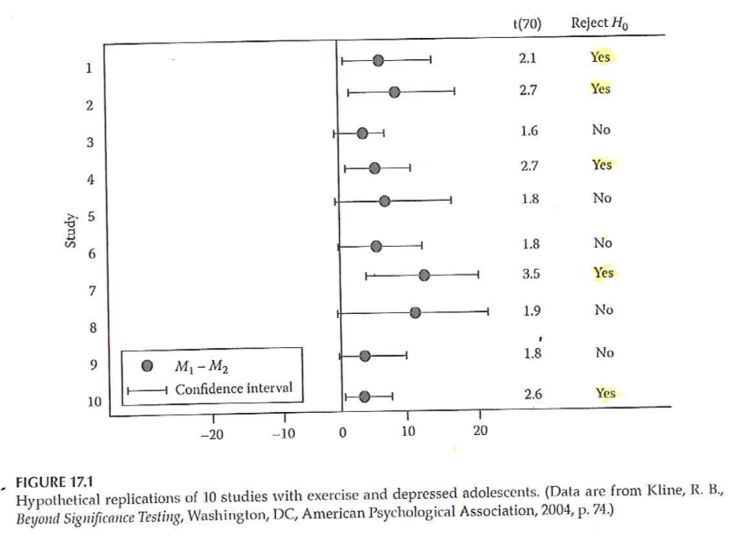
Making Inferences - EBA
Notes:
Interpreting 95% CI (Fig 17.1)

Slide 132
Making Inferences – EBA
Effect size –
Strength of relationship between IV & DV
Magnitude of the difference between levels of the IV with respect to the DV
3 types of effect size measures
r family
d family
Measures of risk potency

Slide 133
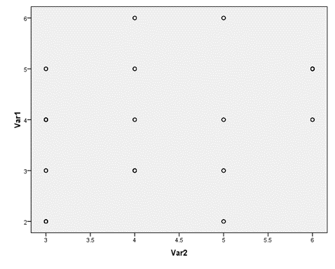
Making Inferences – EBA
Notes:
Why is effect size at least as important as significance level?
Influence of sample size on results

Slide 134
Making Inferences – EBA
Effect sizes –
Unstandardized – in the units of the raw DV
Standardized –
Standardized using pooled standard deviation of the groups
Measure that can be used to compare to other studies with different DVs

Slide 135
Making Inferences – EBA
Types of effect sizes –
R family – strength of association
D family – magnitude of differences
Measures of risk potency – when both IV and DV are dichotomous
Odds ratio
Relative risk
Risk difference

Slide 136
Making Inferences – EBA
R family of effect sizes – association
r 2 vs r
Cohen’s guidelines
Weak approx +/- .1
Medium approx +/- .3
Strong approx +/- .5
Authors labeling
Less than typical
Typical
Greater than typical
Also rho, phi, eta, R

Slide 137
Making Inferences – EBA
D family of effect sizes – differences
d <U+F0E8> Two group comparison
Treatment group mean – Comparison group mean
Divided by pooled standard deviations from both samples
eta 2 <U+F0E8> Multiple group comparison
Statistics packages will compute
Interpret like r 2 (amount of variance in DV accounted for by IV)

Slide 138
Making Inferences – EBA
Risk family of effect sizes – When both IV and DV are dichotomous
Phi – measure of association / correlation
Clinical / medical research – the risk of clinical outcomes
Relative risk – ratio that compares the risk of an outcome between groups
Risk difference – percentage difference that compares risk of an outcome between groups
Odds ratio – Odds of outcome in control group compared to odds in treatment group

Slide 139
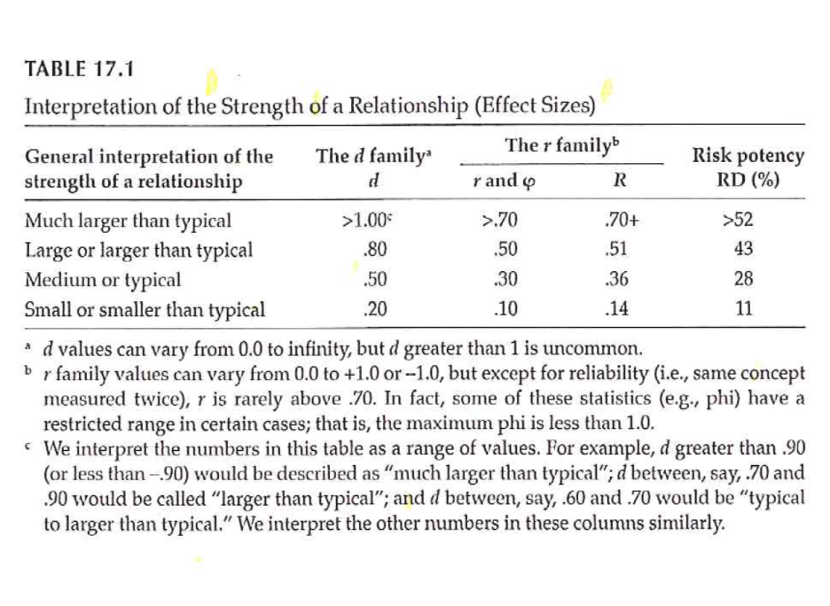
Making Inferences – EBA
Notes:
Interpretation of effect sizes –

Slide 140
Making Inferences – EBA
Value of effect sizes –
Indicates the strength of a relationship or a difference
Allows you
Combine results from studies with dissimilar outcome measures
Use findings of previous study to plan study with different outcome measure
Online source to perform power analysis –
Sample Power (part of SPSS)
Russell Lenth – U of Iowa

Slide 141
Making Inferences – EBA
Meta-Analysis
Research synthesis of multiple studies
Uses effect size value from each study
Advantage over systematic review – compute a summary statistic that represents overall estimate
Provides evidence of reliability of research finding
Include findings from studies that failed to find statistical significance
Increased external validity

Slide 142
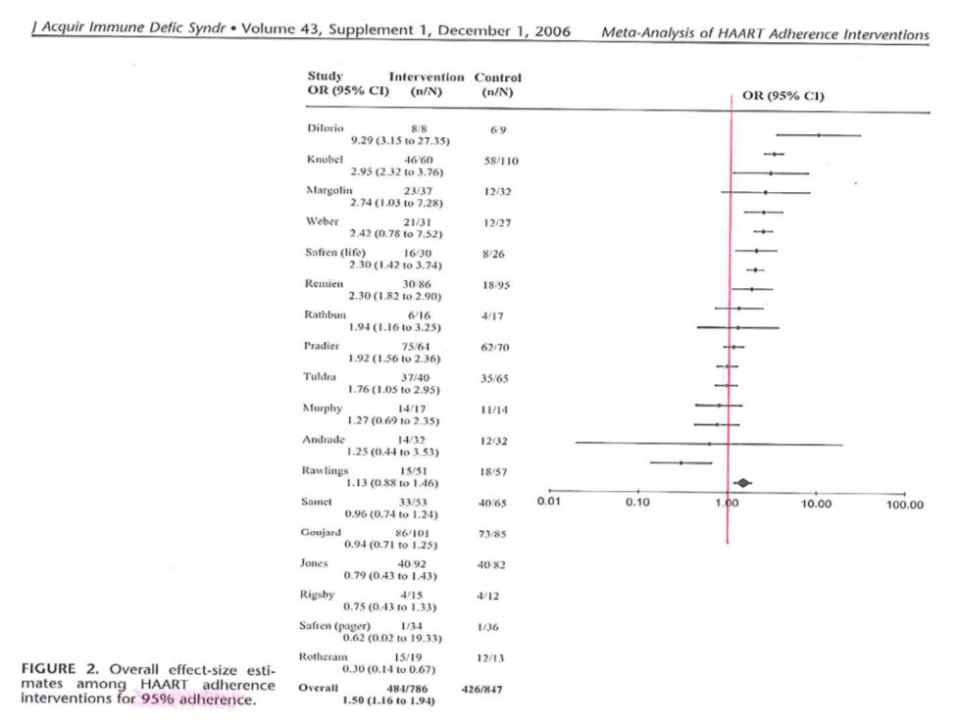
Making Inferences – EBA
Notes:
Simoni et al., 2006

Slide 143
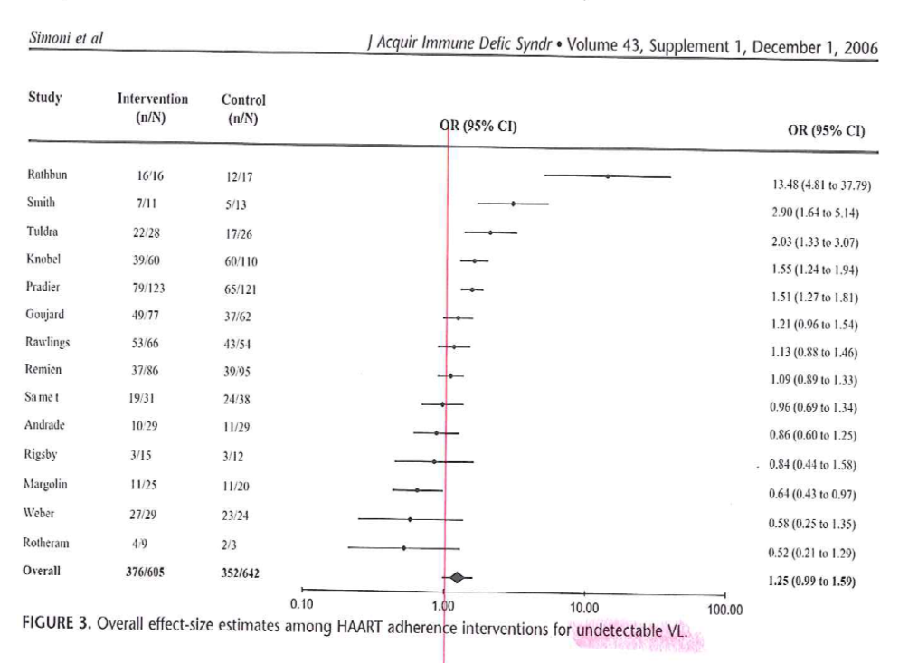
Making Inferences – EBA
Notes:
Simoni et al., 2006

Slide 144
Assignment #9
Complete an “outline” of your written proposal. Refer to the “Research Proposal Structure Overview/Structure” document in the Course Content folder on Blackboard. This “outline” should reflect a substantial amount of detail including sub-headings in the literature review section and methods section. Sections that reflect earlier assignments should contain near-complete drafts of the information that is relevant to your proposed project.
Available resource –
Research Proposal Structure Information document
Week by Week / General Information

Slide 145
Assignment
Prepare an “outline” for your written research proposal that is the final project. The outline should include the various sections that should be in the Methods section of the proposal. Given the work done on the previous assignments, this outline should include a substantial amount of detail.
Prepare for next weekâ€™s session

Slide 146
Discussion questions
What is meant by the “null hypothesis” versus a “research hypothesis”; which is being tested by the statistical analysis of the data; and can you “prove” a null hypothesis?
Will you include research questions or research hypotheses in your research proposal?
Do you have information available that is needed to determine sample size for your planned research project?
What outcome variables will be the focus of your research questions/hypotheses?

Slide 147
Additional slides

Slide 148
Sampling
Sample size
General rules
Representativeness vs number
Impact of having very large sample sizes
Generally –
Need sample to be large enough so you don’t miss important findings
If very large sample, need to distinguish statistical significance vs clinically important
Notes:
How many people do I need. This best done using a power analysis. Take account of the measures being used and what you expect to see. Information from previous research or other kinds of things.
Representativeness is more important than the absolute size of the sample.
Large enough so you don’t miss important findings.
In cases with really large sample sizes where you get statistical significance without practical significance. Effects.

Slide 149
Internal Validity
“The extent to which we can infer that the independent variable caused the dependent variable.”
For non-experimental studies –
How “well designed and conducted” was the study?
Three criteria for causality
Notes:
It’s really only randomized trials that can establish causality. But even in quasi-experimental and non-experimental studies, you can still talk about internal validity.
The cause has to precede the effect, it must be connected to the effect, and there must be no other variables that could explain why the cause is related to the effect.

Slide 150
Internal Validity
“The extent to which we can infer that the independent variable caused the dependent variable.”
Three criteria for causality
IV must precede the outcome variable
IV must be related to the outcome
There must be no other variables that could explain why the IV is related to the outcome

Slide 151
Internal Validity
Three criteria for causality –
IV must precede the outcome variable
IV must be related to the outcome
There must be no other variables that could explain why the IV is related to the outcome
By Research Approach –
Randomized Exp
Quasi- Exp
Comparative
Associational
Descriptive

Slide 152
Internal Validity
Notes:
For randomized designs, the cause precedes the effect, the cause is related to the outcome and there are no other variables that could explain the relationship.

Slide 153
Internal Validity
Meeting the 3 causality criteria based on –
Strength of the research design
Internal validity
Notes:
The strength of the research design and the internal validity determine whether you can claim causality. Try to design the study to maximize internal validity.

Slide 154
Internal Validity
Internal validity -
Most often discussed with reference to randomized experimental and quasi-experimental designs
Can also be applied to non-experimental studies

Slide 155
Internal Validity
Evaluating the internal validity of a study –
Equivalence of the groups on participant characteristics
Control of extraneous experiences and environmental variables
Notes:
There are two aspects of internal validity, equivalence and control.

Slide 156
Internal Validity
Equivalence of the groups on participant characteristics –
Are groups equivalent prior to introduction of IV?
Randomized experimental design –
Random assignment
Quasi-experimental design –
Random assignment of treatments
Matching
Checking pretest scores
Notes:
Random assignment assures equivalence of the two groups on average. A rule of thumb is 30 people assigned to each group should give you confidence that random assignment will assure equivalence. If you are using random assignment, you should not need to test for baseline equivalence. We feel that random assignment is the best way to achieve equivalence.
In quasi-experimental design, you don’t have random assignment, but you can randomly assign between the two groups. You can also use matching to achieve equivalence. Finally, you can check baseline scores for equivalence.

Slide 157
Internal Validity
Equivalence of the groups on participant characteristics –
Are groups equivalent prior to introduction of IV?
Comparative design –
Statistical adjustment (ANCOVA) to adjust DV scores to make groups more nearly equivalent
Matching participants on variables other than the primary IV
E.g. Case-control study
Check after the study for comparability
Notes:
Since non-randomized trials have an attribute variable, you need to rely on statistical adjustment or matching. You can also check after the study for comparability.

Slide 158
Internal Validity
Equivalence of the groups on participant characteristics –
Are groups equivalent prior to introduction of IV?
Associational design –
Only 1 group
Not able to provide evidence of causation
“Equivalence” – “… whether those who score high on the IV … are similar to those … who score low in terms of other attributes that may be related to the DV.”
May be able to provide some statistical control
Notes:
Equivalence when you have a continuous independent variable means that those who score high on the variable are similar to those who score low.

Slide 159
Internal Validity
Control of extraneous experiences and environmental variables –
Extraneous variables – variables other than the IV and DV
Environmental variables – conditions/variables that occur during the study
Contamination
Issue – Is one group affected more than the other(s)?
Less of an issue with a more controlled research setting
Notes:
Your study could be contaminated by other variables. These variables might be out of your control but which can influence the outcome.
Contamination: people in the intervention group are friends with the control group and share information.
The key issue is whether one group is more affected by extraneous variables.
In a controlled setting, there are fewer extraneous variables, but this changes in a field setting.

Slide 160
Internal Validity
Rating the dimensions of internal validity
Figure 8.2
Evaluating Research Validity framework
“Good” study – moderate to high internal validity on both dimensions
Notes:
Internal validity is measured by whether the two dimensions are addressed.

Slide 161
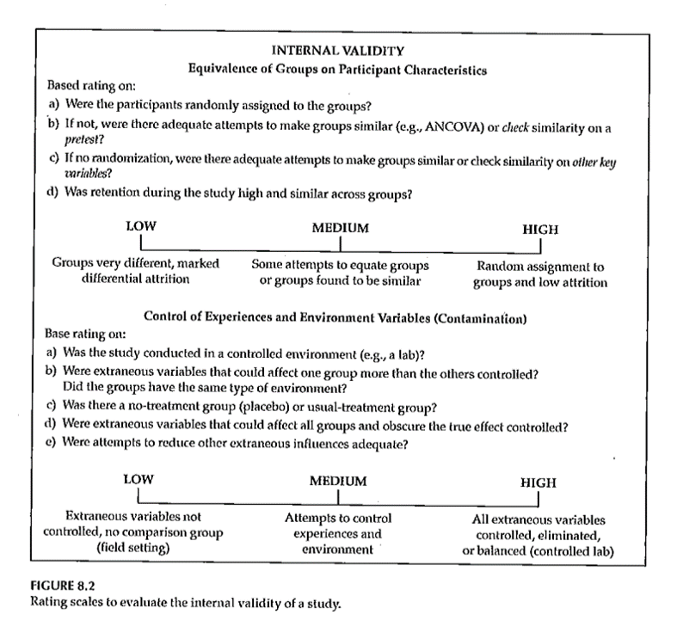
Internal Validity
Rating the dimensions of internal validity
Notes:
Figure 8.2.

Slide 162
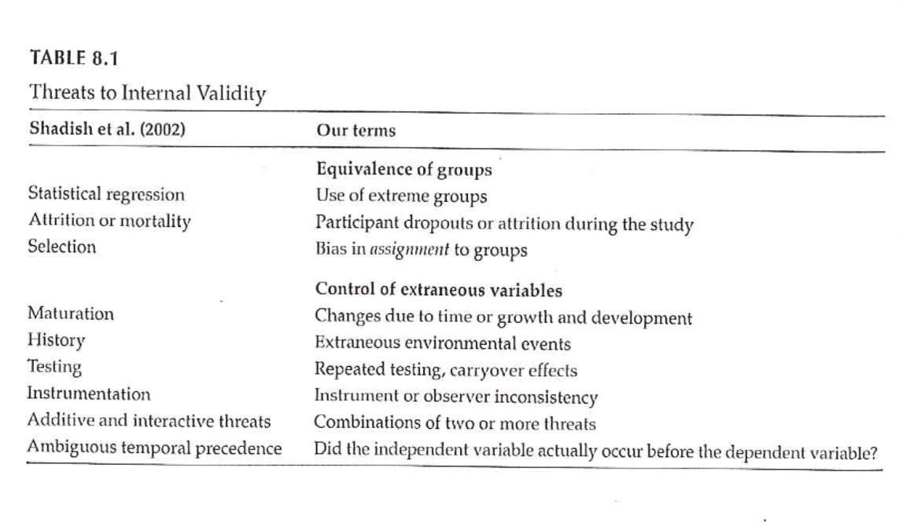
Threats to Internal Validity
Notes:
Table 8.1 relates statistical terminology to identify threats to internal validity. This table tries to take those technical terms and express them
Extreme groups have issues with regression to the mean. Even without any intervention, the extremities will tend to lessen.
Dropouts or attrition means that you’ve designed a setting that is so difficult that no one can stay in. Differential attrition is especially troublesome.
Bias in assignment occurs when patients or their physicians directly or indirectly influence the assignment. Random assignment eliminates this bias.
Cook and Campbell.

Slide 163
Threats to Internal Validity
Equivalence of Groups
Use of extreme groups
Participant dropouts or attrition during the study
Bias in assignment to groups

Slide 164
Threats to Internal Validity
Control of extraneous/environmental variables
Changes due to time or growth and development
Extraneous environmental events
Repeated testing, carryover effects
Instrument or observer inconsistency
Combinations of two or more threats
Did the IV actually occur before the DV?
Notes:
Here are some of the sources of extraneous variables.
Maturation.
History. Something that occurs between the pre and post measurements that is independent of the intervention but which can influence the outcome.
Worry about sensitization to the issue in the baseline measurement that causes people to go out and find more.
Long studies have problems with instrumentation or observers (e.g., because of turnover).
There are also combinations of these events where one magnifies the other.
Temporal order of the variables. If you can’t assure that the independent variable occurs before the dependent variable, you can’t establish causation.

Slide 165
Threats to Internal Validity
Other threats
Effects of being in the control group
Expectation effect
Control for expectation
Observer / experimenter bias
Notes:
Control group contamination. Demoralization.
Hawthorne effect.
Blinding helps control for expectation effects and observer bias.

Slide 166
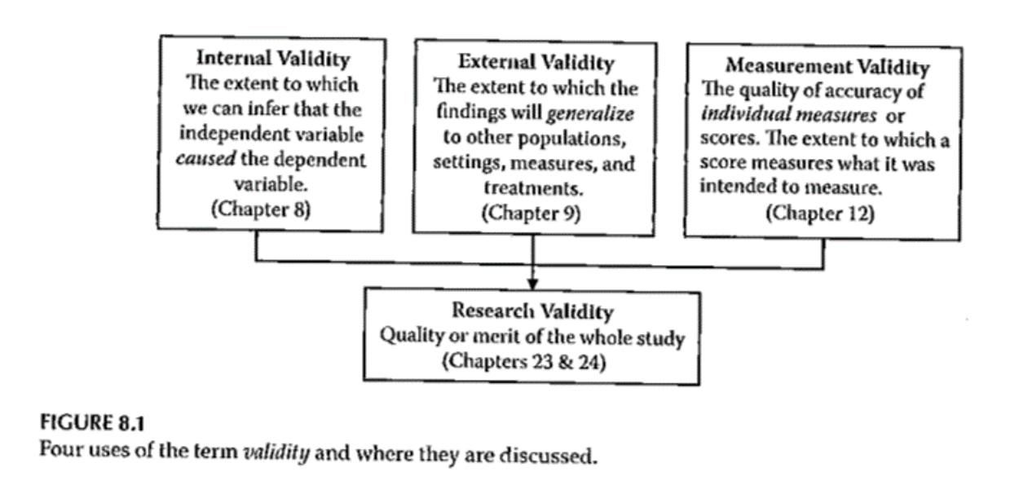
Validity
Notes:
Here is figure 8.1 again. The next part of this lecture talks about sampling and external validity.

Slide 167
Validity
Notes:
Here is figure 8.1 again. The extent to which results will generalize.

Slide 168
Assignment #7
Generate a list of variables that you plan to include in your research proposal. Include in the list both dependent and independent variables. In the list include:
Variables you will need to describe your sample,
Variables you will need to control for in your analysis, and
Variables you will need in order to test your RQ/RH.
Notes:
RQ=research question, RH=research hypothesis.

Slide 169
Measurement
What do we mean “ measurement ” ?
assignment of numbers or symbols to the different levels or values of variables according to rules. ”
Notes:
We are talking about measurement this week. You are either taking stats or have taken it in the past. This is not a statistics class. Think about what type of variables you will collect and propose what statistical analysis.
Your book defines it as the assignment of numbers or symbols. Notice that this takes a quantitative approach. But even in a qualitative study, you still going to want to summarize information like demographics of your sample. Describe the quality or quantity of a variable.
There are qualitative or quantitative ways to measure things like pain.
We can also use measurements to make absolute decisions. Establish a cut-point.
Conditions, distinctions.

Slide 170
Measurement
Assigning a number to represent …
Continuous value
Discrete value
Precision of measurement
Continuous variable …
Discrete variable …
Notes:
Value that is assigned can take on any value. Preciseness is dependent on the device used to collect the measurement. It could be the precision of a laser versus a cruder measure. Precision should be appropriate to what you are trying to get at. Lack precision does not mean that your results are not continuous. If you round to the nearest inch, you still are measuring an underlying construct that can take on more precision. Example is blood pressure, interbeat interval, where rounding is done but it still represents a continuous variable.
Discrete values because of rounding, using counts, or a limited number of categories. As long as it represents an underlying construct, consider it as continuous.

Slide 171
Measurement
What is the measurement representing?
Actual measurement …
Length, time, …
Indirect measurement
Constructs
Whatever you are trying to measure ..
Must be able to define it!
Notes:
A survey or scale to get at depression, pain, those kind of things. These are abstract variables.
Bottom line is to define and operationalize how you measure something. It’s easy to say something like quality of life but you have to pin this down and establish measurement validity. Consistency is important to avoid measurement bias.
Even for pretty obvious values like blood pressure, there are different ways to measure and you need to choose a single method for consistency and careful control, and when there are multiple methods, chose the method that is optimal for your needs. Blood pressure, for example, can be influenced by whether you are sitting or standing and whether you are talking while the measurement is being done.
Formalizing the rules for measurement helps reduce bias. This is a real concern when you have a variety of people doing the same measurements. How are new hires trained? Can you verify that they are trained to the standard that you have promised.

Slide 172
Measurement
Traditional levels (scales) of measurement
Nominal
Ordinal
Interval
Ratio
Notes:
Nominal means names, classification, or categorical assignment. Names are mutually exclusive and exhaustive. Value that is shown is a number code or a text word.
Ordinal is similar to nominal plus some orderliness as to what those responses mean. Example five point scale.
There is no true zero point. Can’t perform arithmetic operatitons on ordinal variables.
You can talk about the direction of change.
Interval - difference between levels is consistent across the range of the scale.
Ratio. There is a true zero point.

Slide 173
Measurement
Authors categorization of levels of measurement
Nominal
Dichotomous
Ordinal
Normally distributed
Table 10.1
Notes:
Gliner et al have a slightly different take. They talk about a normally distributed scale. It is hard to talk about the difference between ordinal and interval.
Look at the literature in the area you work with. Several Likert scales summed to get a subscale.

Slide 174
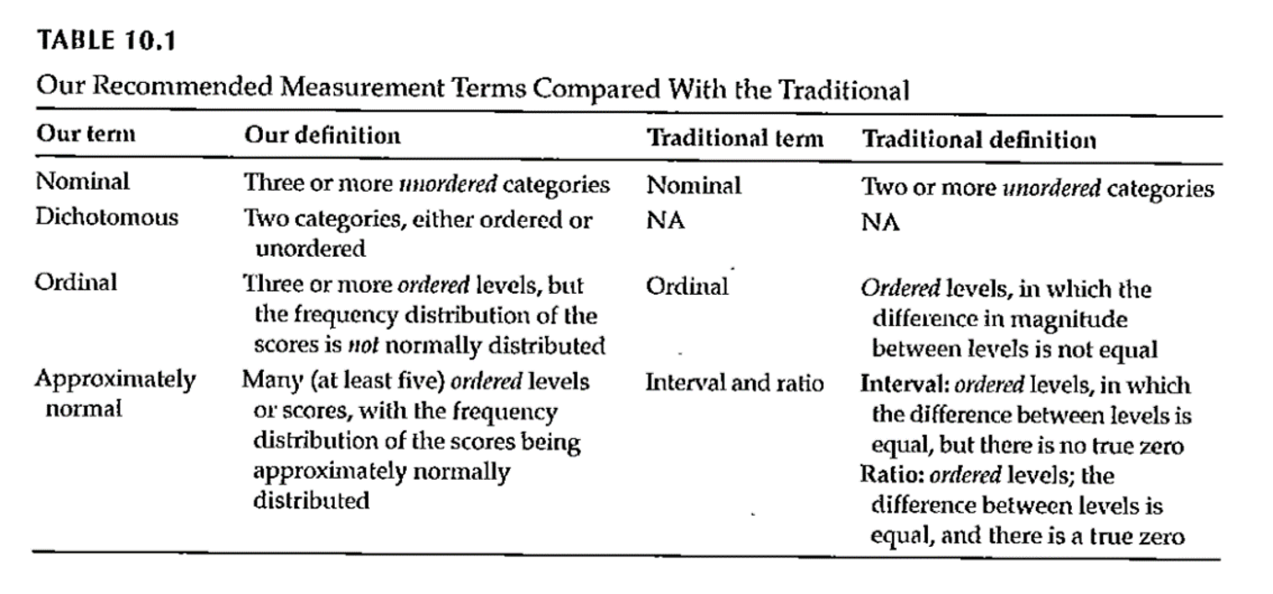
Measurement
Notes:
Table 10.1. This scale splits nominal into those with two levels (dichotomous, also known as binary) and more than two levels (nominal).
Remember how you coded nominal variables. You can (and should) use zero-one coding for dichotomous variables.
The average of a zero-one coded variable represents a probability.
Approximately normal scale requires at least five levels accorind to Gliner et al.

Slide 175
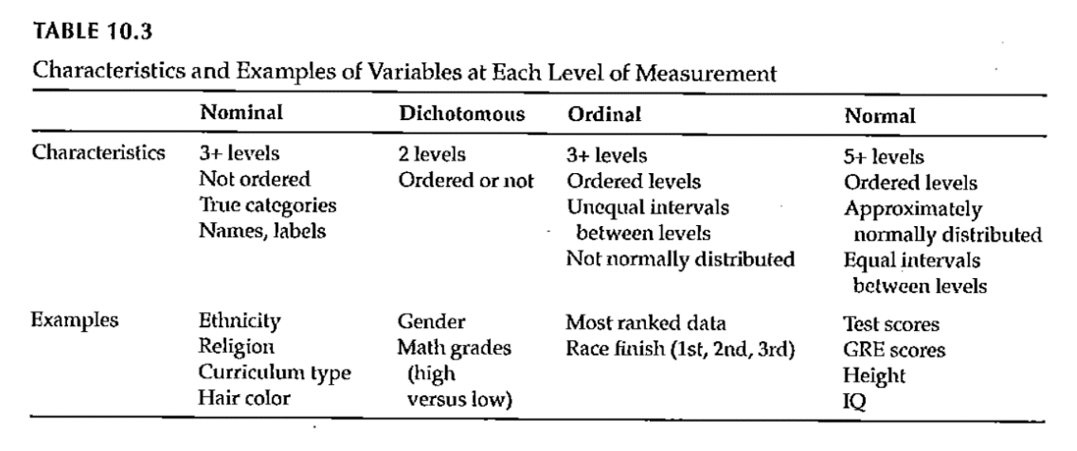
Measurement
Notes:
Table 10.3 gives examples of the Gliner et al scales.

Slide 176
Measurement
Why does the scale of measurement matter?
How it reflects your design and your research question
How it determines the types of statistical analyses you will do
How it defines what you can say about your results
Notes:
The level of measurement comes from what you are trying to get at in your research.
Measurement scales can limit what you can say about your results.

Slide 177
Assignment #6
Prepare a brief paragraph that describes the research design you are using for your research proposal. This is the information that will probably appear in the Methods section of your proposal.
Notes:
Go back are refer to Figure 4.1. Week 8 activities relate to the exemplar articles. These are on the Canvas site. There are six included. Pick one and get familiar with it.

Slide 178
Assignment
Prepare a brief paragraph that describes the research design you are using for your research proposal. This assignment will be used to describe the study design in the Methods section of your research proposal.
Prepare for next weekâ€™s session

Slide 179
Discussion questions
No discussion questions this week.

Slide 180
Additional slides

Slide 181
External Validity
Generalizability
Fig. 9.3
Evaluating Research Validity Framework
Two main aspects
Population external validity
Ecological external validity
Notes:
The extent to which results can be generalized beyond this study. Extrapolate to the bigger world.
Evaluating freamework (questions 14 and 15).
Population: how participants were selected.
Ecologic validity: the more control you have, the better the internal validity but the less like it is for real world. The naturalness of the setting, rapport.
Figure 9.3.

Slide 182
External Validity
Population external validity
How participants were selected for the study?
Is sample representative of the target population?
Validity framework

Slide 183
External Validity
Ecological external validity
Whether the results can be generalized to real-life outcomes
Trade-off with control of study
Validity framework

Slide 184
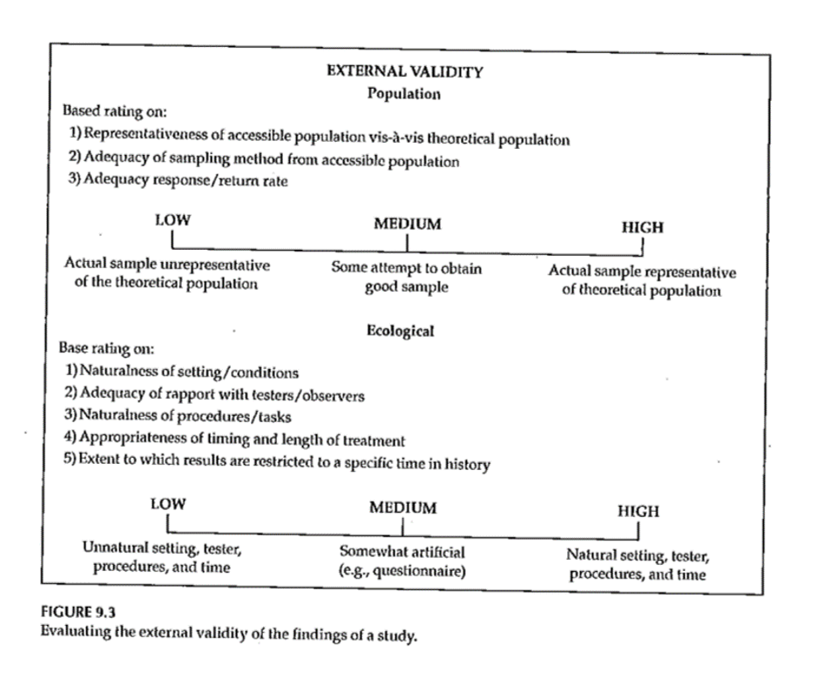
External Validity

Slide 185
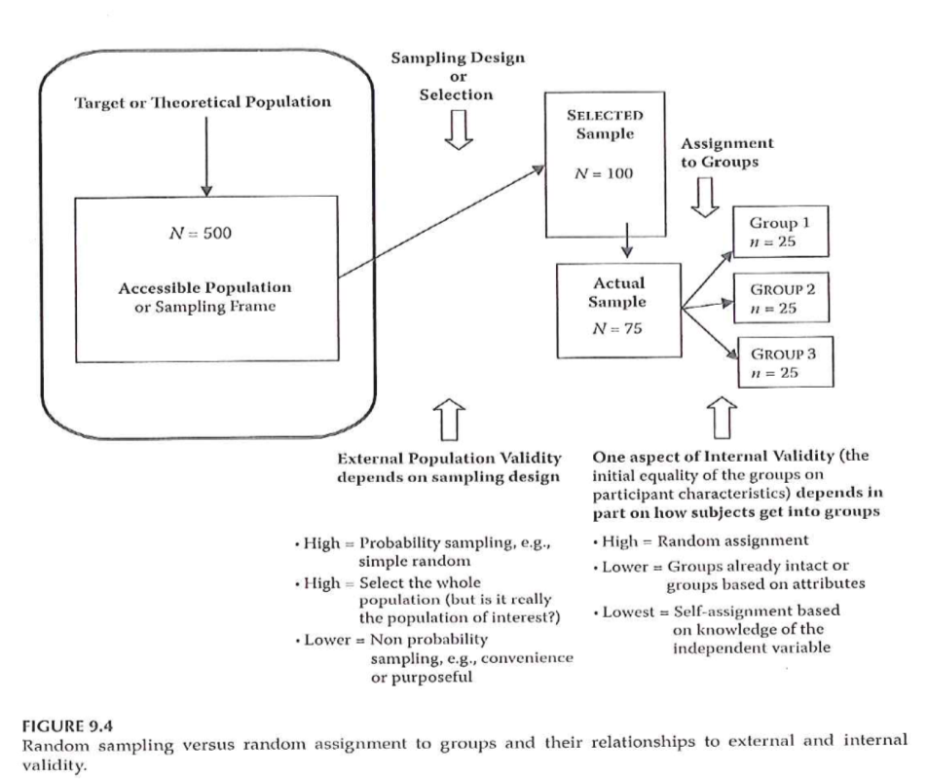
Sampling and Validity
Notes:
Figure 9.4. External validity is influenced by the sampling process. Internal validity is influenced by the allocation of this sample to treatment groups.

Slide 186
Measurement Validity
Internal structure evidence –
“Evidence from several types of analysis, including factor analysis and differential item functioning …”
Does an analysis of the internal structure of a measure match the conceptual framework?
Notes:
Factor analysis is a method of grouping items representative of individual constructs.
In the week 9 folder is the MOTIV* document. The CES-D score has twenty items rated on a 0 to 4 scale, with four of the items reverse scaled.
There is a somatic factor in this scale. This might be considered a subscale. Run a factor analysis, even though it only has four levels. Do the items all hang together.

Slide 187
Measurement Validity
Factor analysis – Beliefs about ART measure
The following questions involve your personal views about the HIV medications that have been prescribed for you. Please indicate the extent to which you agree or disagree with the following statements.
Response scale: 1 (strongly disagree), 2 (disagree), 3 (uncertain), 4 (agree), 5 (strongly agree)
Notes:
The ones in yellow. Multiple items to represent a measure. Is there variability in any of those items. If you had selected one and only one item, it might be influenced by external factors like your mood. Multiple items avoid this problem.
The N items had Cronbach’s alpha of ?? and the C items had Cronbach’s alpha of ??.
A factor analysis allows us to see if the measure is behaving the way we expect it to.

Slide 188
Additional topics
Pilot studies
Questionnaires. http://www.pmean.com/02/questionnaire.html

Slide 189
Data Collection Techniques
Notes:
Table 13.1 is useful in terms of the various things that we will touch on. It classifies by the two types of quantitative research and by qualitative research. Organized by the potential amount of patient filtering. The ones at the top should have less participant filtering. Also note that the symbols are not hard and fast rules, but represent the likelihood.

Slide 190
Data Collection Techniques
Standardized vs Investigator-Developed Instruments
Development and Use
Evidence to support investigator-developed instruments
Notes:
There is a lot of work in the development of standardized instruments, manual and documentaiton, normative values, apply to a broad area. Investigator developed instruments focus on a more specialized area, but you still need to supply information on validity and reliability.
Whenever possible use instruments already in use. You can find these in places like PROQOLID. This originally started as quality of life measurements, but has expanded. NIH compilation of patient reported outcome measures (PROMIS). NIH wants the research community to use common measures to allow easier compilation of studies in a meta-analysis.

Slide 191
Data Collection Techniques
Researcher-Observed Measures
Naturalness of the setting
Observer “participation”
Amount of detail
Breadth of coverage
Notes:
The focus is on direct observation. The more natural the setting, the less control you have. This might hurt the internal validity of the study. It is a trade-off.
How much does the observer participate. In interviews and focus groups, there is a very clear high level of participation. On the other extreme, observation in public places might not have any knowledge of their participation. In the middle are studies where participants know they are being observed, but this knowledge may fade into the background.

Slide 192
Data Collection Techniques
Tests and Documents
Standardized tests
Norm referenced test
Criterion referenced test
Achievement tests
Performance and Authentic assessments
Aptitude tests
Documents
Content analysis
Notes:
Norm scores allow you to compare to other scores (historical comparisons). These tests are very objective, but there is some subjectivity, perhaps, in their interpretation.
Measuring actual performance (ecologic validity). Tries to be very relevant to the setting.
Use existing documents. Existing records might have a higher level of accuracy but there is no gauarantee. Time is shorter because the documents already exist. Data extraction takes time. Do you need consent from the people associated with these documents.
Data abstraction is tedious, but the newer systems like i2b2 allow you to get the information more directly.
Content analysis is a more qualitative review. It gives you a lot of valuable information that a quantitative approach might miss.

Slide 193
Data Collection Techniques
Self-Report Measures
Standardized Personality Inventories
Attitudes / Beliefs scales
Likert scale
Semantic differential scale
Questionnaires
How delivered / administered
Item types
Interviews
Focus groups
Notes:
Personality inventories: the validity is dependent on an individual’s self-awareness.
Attitudes and beliefs done for a variety of purposes. A “representative sample of all possible opinions or attitudes about a particularl subject.” That’s why measurement experts cringe when you ask a single question. You need a multiple set of items to get at how people feel.
The Likert scale is very popular. You may not see the semantic difference scale, but examples will follow.
Delivery by mail or Internet. There are pros and cons to all formats. Item types could include open ended, partial (responses plus other), and close ended responses.

Slide 194
Descriptive Research
Surveys
Methods
Interview
Questionnaires
Design of surveys
Research question
Review of existing instruments
Process of designing survey
Notes:
Interview allows you to probe for comments. Video as well as audio is now available. It takes time and training. Concerns about anonymity with an interview.
Questionnaires are self-administered. Return rates are a concern. When sent out blindly, you can get low return rates, which hurts the generalizability of the study. There is potential for misunderstanding and people may get into a routine response and not provide as good quality of response.
Design the survey to address your research question. Thing about the pieces and the order.

Slide 195
Data Collection Techniques
Surveys
Survey question format –
Open ended
Close ended
Wording of questions
Scales
Scale of measurement
Response options
Notes:
Even as simple as something like age, you can ask it in an open ended format that allows you to categorize any way you like or even to forgo categorization.
Wording is important. Simplicity and reading level. Use standardized scales whenever you can.
Double-barreled questions. [[Ask option about supervisors and managers]]
How many times questions, think about the time frame (over the past 24 hours, past week, past month). Shorter time frames better recall, but subject to more external variations.
Building a level of trust. Don’t ask people to admit to “bad behavior”. Think of it from the perspective of the person providing the information.
[[Income: actual versus categories]]

Slide 196
Data Collection Techniques
Notes:
Open ended vs Close ended
Respective roles of open or close ended format. This is a nice guide.
.footnote[Sim & Wright, 2002]

Slide 197
Data Collection Techniques
Notes:
Surveys – Response Options
Likert
.footnote[Portney & Watkins, 2009]
Example of five points (SD, D, N, A, SA)

Slide 198
Data Collection Techniques
..
Notes:
Everyone uses the term Likert with a hard-i, but the persons who developed this scale used a soft-i.
All items contributing to a total.
Some debate about the number of categories. Odd versus even. Even forces an opinion. Also a debate over a large versus a small number of items.
Do you want to reverse code some items. It could help keep the participants alert and thingking This may end up confusing. [[13 questions, but question 8, first question on the bakc page, was the only reverse coding.]]
Surveys – Response Options
Likert
.footnote[Sim & Wright, 2002]
Figure 15.8 is a different version of a five point scale.
Commercial plug for REDCap. Entry on a tablet. Coding is done on the back-end.

Slide 199
Data Collection Techniques
Notes:
Surveys – Response Options
Likert
.footnote[Sim & Wright, 2002]
Figure 15.9 shows a seven point response.
IRB insistence on a “Prefer Not to Answer” response. Contrast this to a “Neutral” option.

Slide 200
Data Collection Techniques
Notes:
Surveys – Response Options
.footnote[Sim & Wright, 2002]
Figure 15.3
These scales seem backwards to Mary. You don’t necessarily need to include the numbers are on the form. They can be added on the back end.

Slide 201
Data Collection Techniques
Notes:
Surveys – Response Options
Figure 15.4, Sim & Wright, 2002.
Not at all, somewhat, moderately, very much, extremely.
Note that the largest number is associated with “not at all”.
Double check that everyone agrees that somewhat is less than moderate, very much is less than extremely.

Slide 202
Data Collection Techniques
Notes:
Surveys – Response Options
Figure 15.5. [Sim & Wright, 2002]
Good, Fair, Poor is a three point scale. Add Very good for a four point scale. Add Excellent to get a five point scale.

Slide 203
Data Collection Techniques
Notes:
Surveys – Response Options
Semantic Differential
Figure 15.4 [Portney & Watkins, 2009]
This is an example of a semantic differential. Seven point scale. Only label the extremes. Notice the reverse scaling of some items.

Slide 204
Data Collection Techniques
Notes:
Surveys – Response Options
Semantic Differential
Figure 15.11 [Portney & Watkins, 2009]
A second example of a semantic differential scale.

Slide 205
Data Collection Techniques
Notes:
Surveys – Response Options
Visual Analogue Scale (VAS)
Figure 15.5. [Portney & Watkins, 2009]
Commonly used for pain. Usually the line is 100 mm long. Gives you a number from 0 to 100, which allows you to treat this as a continuous variable.
Anchors at each extreme.
How do you handle a check mark.
This is a very labor intensive data entry task.
Note that the photocopy process can change the length of the scale (102 mm versus 100 mm).

Slide 206
Data Collection Techniques
Notes:
Surveys – Response Options
Numerical Rating Scale
Figure 15.1 [Sim & Wright, 2002]
This scale has 7 numbers with anchors at each end.

Slide 207
Descriptive Research
Surveys
Pit-falls and words of caution
How responses are recorded
Wording of items
Literacy level
“ Loaded ” wording
Complexity of items
More than 1 “ unit ” in a single item
Clearly stated terms
Notes:
There are ways of checking the reading level of the survey. Good instructions. Branching (if “no” skip) patterns need to be laid out very clearly.

Slide 208
Data Collection Techniques
Notes:
Sim and Wright. Sources of bias in attitude measurement.
Social desirability, conformity, denial, acquiescence.
Leading questions, loaded terminology, presumptive (wife-beating)
Response set (stuck on the same value), or tendency to extremes.
Example of “push polling.”
“Any other comments?” http://www.biomedcentral.com/1471-2288/4/25.
http://www.pmean.com/04/DesigningQuestionnaire.html

Slide 209
Data Collection Techniques
Surveys – Example
Using a scale of 0 to 100, please indicate the percentage of time you take all the doses of your medicine?
… take all the pills in each of your doses?
… take all doses on the prescribed schedule?
… follow all special instructions …
… make sure you refill all of your medications on time?
Notes:
Medical history interview. Anti-retroviral medication, but some had no history yet, so used adherence in general. This gets tricky with multiple medications.
There’s an issue that came up when using this study, which will be discussed in the discussion board. Answer these questions yourself, and how you based your response to the second through fourth items.

Slide 210
Data Collection & Coding
Notes:
Figure 2.1 from your book. This is back from Chapter 2, and keep this in mind when you are designing your data collection.

Slide 211
Data Collection & Coding
Initial Steps
Planning the study
Pilot testing
Data collection
Check for completeness if possible
Notes:
How things are working, where there is lack of clarity, how long does it take, where the systems don’t work.
Make sure that your extraction process is complete as possible for secondary data. For prospective surveys, flip through a survey upside down to see if items are all filled in. Hope that you haven’t missed a page. Electronic collection can force someone to respond before they answer the next question.
[[Ethically can’t force someone to complete a questionnaire.]]
How do you handle multiple responses.
Code the maximal detail of variables like age so you can collapse as you see fit. Make sure that you code missing or ambiguous responses consistently.
REDCap is great!
[[Double entry coding]]

Slide 212
Data Collection & Coding
Data Coding, Entry, and Checking
Guidelines
Mutually exclusive levels
Code for maximum information
Record is as complete as possible
Consistency
Data entry form
Checking entry

Slide 213
Data Collection & Coding
Notes:
Figure 15.2. Completed survey with callout boxes showing how we handled problem responses.

Slide 214
Data Collection & Coding
Data Entry into Statistical Program
Layout of data sheet
Variable names
Labeling
Variables
Values
Codebook / documentation
Notes:
[[See Intro to SAS/R material]]
By thinking about the backend process, you can sometimes fix things before you collect the data.
Mary uses Excel for documentation, but never for analysis, rarely for data entry.
Summarizes factor analysis, Cronbach’s alpha. Note whether better to have high score or better to have low score.
[[EUSpRIG site]]

Slide 215
Data Collection & Coding
Data Summation
Descriptive information
Categorical variables
Continuous variables
Data checking – part 2
Notes:
Look for inconsistent values, outliers, invalid values.
Note that certain responses on one question might lead to limits on the responses to other questions. Example, ever smoked? versus How many years?

Slide 216
Data Collection & Coding
Notes:
Figure 15.4 shows SPSS output using descriptive statisticis to check data entry. Example of Likert scale where everyone responded 5. Note the number of responses/missing responses.
Hopefully, you’ve done such a good job planning that these issues don’t arise after the data is collected. [[Ha!]]

Slide 217
Measurement dichotomies
Standardized versus investigator developed measures
Researcher evaluation versus patient report
Field measurements versus laboratory measurements
Ecological validity
Standardized test

Slide 218
Researcher evaluations
Norm referenced tests
Criterion referenced tests
Achievement tests
Performance assessment
Authentic assessment
Aptitude tests
Projective technique
Documents

Slide 219
Self report
Standardized personality inventories
Paper and pencil
Machine scored

Slide 220
Questionnaires
Definitions
Survey
Questionnaire
Interview

Slide 221
Delivery
Remote administration
Mail
Internet (Survey Monkey)
Direct administration

Slide 222
Structure
Open ended
Partially open ended
Unordered closed response
Ordered closed response
Interviews
Telephone
Face-to-face
Focus groups

Slide 223
Analysis of Qualitative Data
http://blog.pmean.com/semi-structured-interviews/
Positivism versus constructivism, revisited
https://www.sagepub.com/sites/default/files/upm-binaries/29985_Chapter1.pdf
http://blog.pmean.com/recommended-philosophy-news-network-postmodernism-special-report/
Tools: semi-structured interviews, participant observation, photo elicitation(?), mapping exercises(?), web and space design workshops(?), archival records, physical artifacts,
Typically, a one-hour interview requires a minimum of three to four hours (or more) of analysis.
Involve the participants in the process, especially for narrative research.

Slide 224
Analysis of Qualitative Data
Inductive process –
Start with the specific (raw data / transcript)
Develop a theoretical framework from the data
Conceptual categories emerge from the data

Slide 225
Analysis of Qualitative Data
Start the study with a research question
This may provide a potential starting point for analyzing text
If you do this, DO NOT let it prevent you from seeing what is in the text
Steps
From raw data to theory building
“ Iterative ” process
e.g. , as you are developing categories, check them back against the raw data – do they continue to reflect the original data?
Notes:
Keep alert and look for things that come out in the material that you were not anticipating. As your categories, go back and compare them against the raw data. Make sure that you allow the data to guide you. Often coding from transcripts. But it is also good to have access to the original recordings. Sometimes there is a doubt about what some was saying (joking or sarcasm). Look for tone of voice and non-verbal cues.
Content analysis is a generic term, but you can look at things like ad messages in magazines that appeal to young adults.
Thematic analysis is looking for patterns.

Slide 226
Analysis of Qualitative Data
Analysis process –
Given research question, may have some idea of a general conceptual structure; serve only as a starting point
Usually work from transcripts
If possible, refer back to audio recordings when needed
Qualitative form of analysis
Content analysis – analysis of the content of communication
Thematic analysis – identifying patterns or themes in the data
Notes:
Break up the text into “bits” that represent specific thoughts. Open coding lots of themes. Axial coding looks at the relationships between themes, builds a superstructure of ideas.

Slide 227
Analysis of Qualitative Data
Category Formation – assign sections (data bits) to analytical categories/themes “coding”
Summarizing the data by identifying similarities and differences / commonalities and contrasts
Categories:
More manageable units of information
“open coding”
Descriptive – Concrete
Interpretive – Abstract
Relational
Cross-reference categories back to text
Makes it easier to revise coding as needed
Notes:
Software allows you to go back and forth between themes and the original text. Cross-referencing is important. Find examples easily. It helps provide validity checks. Does someone agree with your categorization.
Categories need to be faithful to the data. This is internal validity. But you need to place this in a broader understanding.
You need to be careful about trying to quantify this too much. Keep in mind that just because someone talks about something a lot does not mean that this is the most important thing to them. The most important thing might be something that people are uncomfortable talking about.

Slide 228
Analysis of Qualitative Data
Category Formation
Faithful to the data – “internal” aspect
Meaningful to other categories – “external” aspect
Balance
Generality vs Specificity
Inclusivity vs Exclusivity
Number of times idea mentioned does NOT necessarily reflect importance

Slide 229
Analysis of Qualitative Data
Labeling / Revising Categories
Member-generated – “ first-order ” account
Observer-generated – “ second-order ” account
Labels are provisional; may be revised
Iteration – move back and forth between raw data and labeled categories
“ Zoom in ” vs “ Wide angle ” view of the coding
Revision – may end up dividing or combining categories
May establish criteria for category coding
Notes:
Phrasing of the person versus observations generated by the researcher. Labels should be considered as provisional as you work with more complete information. It is an iterative process. Go back to original data. You’re looking at the specific of what’s been told versus a broader understanding.
Establishing the criteria may depend on how many people are doing the coding. If you don’t have a pre-existing structure, the coding may evolve and may involve 100% review (both raters review everything and resolve discrepancy). Then a third person does an audit.

Slide 230
Analysis of Qualitative Data
Saturation – the point at which you are not gaining any new insight, no new categories being identified, no new relationships being defined
Don’t need any additional analysis
Don’t need any additional data collection (if collection & analysis done in parallel)
Determinant – nature of the information being collection – NOT amount of information
Keeping notes – of the coding/analysis process
Help identify categories/relationships
Help if “stuck”
Document analysis process
Notes:
Saturation is a way to assess your sample size. Have you gotten a representative amount of data.
Really important to keep notes of the coding and analysis process, so you can check your work. Allows you to do qualirty checks on the process.

Slide 231
Analysis of Qualitative Data
Role of Judgment
Balancing act –
Level of creativity by coder to identify categories/relationships
Must reflect the informants thoughts
Audit of the coding by an independent person can check for the match between the coding and the source information
Low-inference descriptors
Look for “negative cases”
Notes:
You develop a framework, but that framework must always represent what the subjects have said.
Low inference descriptors are those things involving just the basic words or text.

Slide 232
Analysis of Qualitative Data
Quantifying Information
Pros & Cons
When quantifying might be of value
Simple frequency of occurrence does NOT necessarily reflect importance
Notes:
This was mentioned earlier.

Slide 233
Descriptive Statistics
Notes:
Figure 10.1 shows the standard bell shaped curve.

Slide 234
Descriptive Statistics
Descriptive graphs
How to look at your data
Options for viewing your data
Frequency polygons
Histograms
Bar charts
Notes:
Even for a qualitative study, you’ll still want to describe characteristics of your sample.
For a fancier inferential analysis, you still should start with a descriptive analysis.

Slide 235
Descriptive Statistics
Notes:
Figures 10.2 and 10.3.
Frequency polygon has a line connecting values and implicitly represents a normal distribution.

Slide 236
Descriptive Statistics
Measures of central tendency
Mean
Median
Mode
Notes:
These terms should already be familiar to you. The mean is the best choice for approximately normal distribution. The median is better for non-normal continuous variables and ordinal variables.

Slide 237
Descriptive Statistics
Measures of variability
Range
Standard deviation
Interquartile range
How many categories
Notes:
The standard deviation is considered a poor measure of variability for a non-normal population. The interquartile is the difference between the 75th percentile and the 25th percentile. Define the 25th percentile as the value so that approximately 25% of the values are smaller and 75% are larger.

Slide 238
Descriptive Statistics
Measures of association between 2 variables
Correlation
Pearson
Spearman
Cross-tabulation
Scatterplot
Notes:
A correlation is a value between -1 and +1. There are two versions. Use Spearman for non-normal or ordinal variables.
Cross-tabulation is best for nominal and ordinal variables.

Slide 239
Descriptive Statistics
Notes:
Figure 10.4 shows the relationship between grade level and performance on a math achievement test. It shows a trend line and an R-squared value.
Note that this is an association but not necessarily a causal relationship. Knowledge of one variable helps you predict the other.

Slide 240
Descriptive Statistics
Notes:
Figure 10.5 shows a much weaker relationship between grade level and motivation scale. The trend line is flat and the R-squared value is small.

Slide 241
Descriptive Statistics
Notes:
Table 10.6 shows a cross-tabulation. Mary revised this to include row and column percentages. Orient towards the row totals or the column totals. Row percentages add up to 100% within each row and column percentages add up to 100% within each row.
You might compute both row and column percentages, but only include one in your final table.

Slide 242
Descriptive Statistics
Properties of the normal curve
Unimodal
Mean, median, and mode are equal
Symmetric curve (skew)
Range is infinite
Shape – not too peaked or flat (kurtosis)
Notes:
This is not a Statistics class, but is intended to help you decide how to choose analyses for your research plan.
There are five properties. Unimodal, symmetric (no skewness), infinite range, peakedness or flatness tells you information about the tendency to produce outliers.
[[Talk about range restrictions.]]

Slide 243
Descriptive Statistics
Notes:
Figure 10.1 (normal curve) again.

Slide 244
Descriptive Statistics
Standard normal curve
Definition
How to compute
Effect size
Notes:
Set the mean to zero and a standard deviation of one. The standard normal curve is useful for effect size calculations and power analysis.

Slide 245
Measurement & Descriptive Statistics
Notes:
Table 10.7. This is a great table that tells you what graphical and numeric summaries are appropriate for what types of data. This doesn’t address the statistical tests (inferential analyses).

Slide 246
Making Inferences - NHST
Populations versus Samples
Use inferential statistics
Sample statistics (M, SD) <U+F0E8>
Population parameters (mu, sigma)
Null Hypothesis Significance Testing (NHST)
Null hypothesis (H 0 )
Alternative hypothesis (H 1 )
AKA research hypothesis
Directional
Non-directional
Notes:
We are talking about data analysis and interpretation. Planning. Some of this will be familiar to you. This is not a full statistical coverage of the topic.
Take the data from the sample and make inferences about the population. The sample is a subset. Inferential statistics is the process by which you infer information about the population.
NHST is the traditional way that a huge amount of research relies on.
Null hypothesis is no difference or no relationship. The alternative is often called the research hypothesis.

Slide 247
Making Inferences - NHST
NHST – Goal of research –
Reject the H 0 in favor of H 1
“Reject” the null hypothesis
Practically – “reject” means difference / relationship greater than just random variability
Alternative hypothesis –
3 versions
Non-directional
Directional positive
Directional negative
Notes:
Does the data allow us to reject the null hypothesis. Rejecting means the difference or relationship is greater than what you’d expect due to sampling error.
[[Directional only for two group comparisons or bivariate relationships]]
never talk about proving the null hypothesis. A large p-value does not mean that you proved the null hypothesis. There might be sources of error that lead to failure to reject the null hypothesis.

Slide 248
Making Inferences - NHST
Directional vs Non-directional H 1
Comparing treatment to control
Comparing different treatments
Choosing directional vs non-directional
Basis for choice
Consequences
Statistical analysis
Interpretation
Notes:
Directional is more likely when comparing a treatment to a control [[placebo]]. When comparing two different treatments, you would have to use a non-directional hypothesis.
Is there existing evidence to support a directional hypothesis.
If you use a directional hypothesis, and you get an extreme result in the opposite direction, you can’t claim statistical significance.
Some people think that directional hypotheses are “cheating”.

Slide 249
Making Inferences - NHST
Sampling review
Target / theoretical population
Accessible population
Sample
Inference from the study sample to the population
Notes:
So how well does your sample reflect the population?

Slide 250
Making Inferences - NHST
Notes:
Example
Figure 16.1 from your book.
Flow chart of selecting from a population, randomizing to two groups, and then comparing the results in each group, and choosing between two hypotheses.

Slide 251
Making Inferences - NHST
Accessible population -> Sample
Random assignment to groups
Conduct study and collect data
Conduct statistical analysis
Intervention group: mean = 73
Control group: mean = 65
Notes:
[[This is a re-iteration of Figure 16.1]]
From your basic Statistics class, you may recognize that this setting would require a two-sample t-test.
[[Knowing which statistic to use in what setting is one of the most difficult tasks that you will encounter.]]

Slide 252
Making Inferences - NHST
Significant difference or not?
Inferential statistics – allow you to determine this
Reject the null ->
The observed difference is highly unlikely if the null hypothesis is actually true
Fail to reject the null ->
We can not say that the observed difference is highly unlikely
Do NOT “accept” the null hypothesis
Notes:
[[If a particular sample result is unlikely under the null hypothesis, this causes you to question the null hypothesis.]]
Reasons why you failed to reject the null hypothesis. A poorly implemented intervention, failure to use valid and reliabile measures, quality problems during the study.
Why never say that we accept the null.

Slide 253
Making Inferences - NHST
( Portney & Watkins, 2009)
Notes:
This is a table of possible outcomes H0 true, H0 false versus reject H0, accept H0.
Define power as the probability of rejecting the null hypotheis when the alternative hypothesis is true. [[Since the ]]

Slide 254
Making Inferences - NHST
Notes:
Statistical testing – possible outcomes
Figure 16.2 provides a different way of displaying Type I and Type II errors in a two by two table.

Slide 255
Making Inferences - NHST
Notes:
Statistical testing – possible outcomes
Two normal distributions and bell shaped curves.
Figure 16.3 from your book. Directional negative hypothesis. Example an intervention that results in a reduction in symptoms/pain.

Slide 256
Making Inferences - NHST
Statistical testing
Fig 16.3 – Directional negative
Example – hypothesize that intervention will result in reduction of symptoms
If you made a directional positive alternative hypothesis …. ?
Notes:
[[This is a rehash of Figure 16.3.]]

Slide 257
Making Inferences - NHST
Notes:
Statistical testing
Fig 16.4 – Non-directional

Slide 258
Null value

Slide 259
Critical value

Slide 260
Alpha level

Slide 261
Power Analysis
Probability of rejecting a false H 0
This is a GOOD thing!
Want to maximize this (within reasonable limits!)
What is power analysis
“… the probability that his investigation would lead to statistically significant results.”

Slide 262
Power Analysis
( Portney & Watkins, 2009)

Slide 263
Type I and II errors
~, ~TRUTH, ~, “DECISION”,“H o is true (there is no relationship)”,“H o is false (there is a relationship)”, “Reject H o (you find a relationship)”,“Type I Error Alpha”,“Correct (Decision agrees with Truth ) Power”, “Do not reject H o (you do NOT find a relationship)”,“Correct (Decision agrees with Truth)”,“Type II Error Beta (Power = 1 - Beta)”

Slide 264
Power Analysis
Notes:
Power of a study – probability of rejecting a false null hypothesis

Slide 265
Power Analysis
Statistical power analysis concepts (Cohen)
Significance criterion – alpha
Power – desired level
Sample size
Effect size
Power analysis method depends on research design

Slide 266
Power Analysis
Performing a power analysis when planning a study
What is the study design?
What do you already know about the measure you are interested in?
What significance level to you want to use for hypothesis testing?
What level of power do you want to achieve?

Slide 267
Power Analysis
Notes:
Determining power (Fig 16.1)

Slide 268
Power Analysis
Increasing power –
Alpha level
Formulation of hypothesis
Decrease variability / increase precision
Groups
Outcome measure(s)
Increase sample size

Slide 269
Power Analysis

Slide 270
Power Analysis

Slide 271
Problems with NHST
Knowledge based on outcome of single study
Interpretation of statistical significance
Complications
H 0 is rarely true – in a strict sense
Too large of a sample size – hard NOT to get statistical significance
Significance testing as a dichotomous decision
Interpretation of changes in the p value
Statistical significant versus clinical/ substative meaningfulness
Notes:
There is always a level of uncertainty associated with a single study.
[[ASA statement on p-values]]
[[Sackett article. http://www.cmaj.ca/content/165/9/1226.short or http://blog.pmean.com/physiological-statistics/ ]]
[[ Example of PiFace http://blog.pmean.com/simple-sample-size/ ]]
[[ Range of clinical indifference http://www.pmean.com/04/confidence.html ]]
[[p-values with lots of zeros, doesn’t make up for biases in the study.]]

Slide 272
Improving NHST
Propose specific alternative hypotheses
Use a random sample if possible
Use an outcome variable that has good reliability and validity
Have a good idea of the level of difference that will be clinically important

Slide 273
Making Inferences - EBA
EBA – Evidence-Based Approach
Reliability of findings
Accumulation of evidence
Premise – “… a single study is not sufficient to use as evidence to substantiate a hypothesis or theory.”
Methods
Confidence intervals
Effect sizes
Meta-analysis

Slide 274
Making Inferences - EBA
Confidence Intervals (CI)
Range of scores that should contain the true population score
CI <U+F0E8> An interval around the point estimate
CI <U+F0E8> “… range of the dependent variable scores that should contain the true population difference between means .”
CI computed using sample mean and standard deviation

Slide 275
Making Inferences - EBA
Interpretation of CI –
95% CI most common
95% CI – with infinite studies and computed CI, the true population difference would be found within 95% of the intervals
NOT – .95 probability that true population difference is within the CI computed from our single study
Option – 95% CI for a given study “… estimates the population mean difference with 95% confidence.”

Slide 276
Making Inferences - EBA
Why compute and report CI?
Part of philosophy to encourage replication
Size of interval – “… how much of the estimate might be due to sampling error.”

Slide 277
Making Inferences - EBA
Notes:
Interpreting 95% CI (Fig 17.1)

Slide 278
Making Inferences – EBA
Effect size –
Strength of relationship between IV & DV
Magnitude of the difference between levels of the IV with respect to the DV
3 types of effect size measures
r family
d family
Measures of risk potency

Slide 279
Making Inferences – EBA
Notes:
Why is effect size at least as important as significance level?
Influence of sample size on results

Slide 280
Making Inferences – EBA
Effect sizes –
Unstandardized – in the units of the raw DV
Standardized –
Standardized using pooled standard deviation of the groups
Measure that can be used to compare to other studies with different DVs

Slide 281
Making Inferences – EBA
Types of effect sizes –
R family – strength of association
D family – magnitude of differences
Measures of risk potency – when both IV and DV are dichotomous
Odds ratio
Relative risk
Risk difference

Slide 282
Making Inferences – EBA
R family of effect sizes – association
r 2 vs r
Cohen’s guidelines
Weak approx +/- .1
Medium approx +/- .3
Strong approx +/- .5
Authors labeling
Less than typical
Typical
Greater than typical
Also rho, phi, eta, R

Slide 283
Making Inferences – EBA
D family of effect sizes – differences
d <U+F0E8> Two group comparison
Treatment group mean – Comparison group mean
Divided by pooled standard deviations from both samples
eta 2 <U+F0E8> Multiple group comparison
Statistics packages will compute
Interpret like r 2 (amount of variance in DV accounted for by IV)

Slide 284
Making Inferences – EBA
Risk family of effect sizes – When both IV and DV are dichotomous
Phi – measure of association / correlation
Clinical / medical research – the risk of clinical outcomes
Relative risk – ratio that compares the risk of an outcome between groups
Risk difference – percentage difference that compares risk of an outcome between groups
Odds ratio – Odds of outcome in control group compared to odds in treatment group

Slide 285
Making Inferences – EBA
Notes:
Interpretation of effect sizes –

Slide 286
Making Inferences – EBA
Value of effect sizes –
Indicates the strength of a relationship or a difference
Allows you
Combine results from studies with dissimilar outcome measures
Use findings of previous study to plan study with different outcome measure
Online source to perform power analysis –
Sample Power (part of SPSS)
Russell Lenth – U of Iowa

Slide 287
Making Inferences – EBA
Meta-Analysis
Research synthesis of multiple studies
Uses effect size value from each study
Advantage over systematic review – compute a summary statistic that represents overall estimate
Provides evidence of reliability of research finding
Include findings from studies that failed to find statistical significance
Increased external validity

Slide 288
Making Inferences – EBA
Notes:
Simoni et al., 2006

Slide 289
Making Inferences – EBA
Notes:
Simoni et al., 2006

Slide 290
Assignment #9
Complete an “outline” of your written proposal. Refer to the “Research Proposal Structure Overview/Structure” document in the Course Content folder on Blackboard. This “outline” should reflect a substantial amount of detail including sub-headings in the literature review section and methods section. Sections that reflect earlier assignments should contain near-complete drafts of the information that is relevant to your proposed project.
Available resource –
Research Proposal Structure Information document
Week by Week / General Information

Slide 291
Additional topics
As another aside, I was involved with a similar study (prospective, not retrospective). We planned this study using a one-sided hypothesis (remote prayer has a positive effect on health). The Institutional Review Board suggested changing this to a two-sided hypothesis (remote prayer has either a positive or a negative effect on health). Thankfully, we did not observe an outcome in the opposite tail as that would have been very difficult to explain.

Slide 292
Pilot testing
Clarity of items
Content
“Whether your items cover all aspects of the domain you intend to measure and whether they are in appropriate proportions relative to that domain.”
page 258

Slide 293
Data Collection Techniques
Process of developing a survey
List of measures/variables
What’s already available?
Put the pieces together
Test and revise as needed
Final check – do you really need all of the items?
Analysis of survey data
Notes:
Flows well and is clear.
Get some real test runs with people who have seen it for the first time. Do you really need all of these items?
[[Example of sexual preferences in survey on Internet usage.]]
http://www.pmean.com/10/BadSurvey.html

Slide 294
Coding
Mutually exclusive
Multiple response
“Other” responses
Use number codes for categorical data
Missing codes
Never use blanks for missing (book is wrong)
-1, 99
Multiple codes for multiple reasons
Dummy coding
0/1 for absence/presence
Reverse coding
High is always positive
Tabular format
No more than one piece of information
Double entry coding
Standard coding for race/ethnicity

Slide 295
Variable names
Not too short, not too long
Word delimiters
No spaces, symbols
Example for Mother’s age
Bad choices
mom age
mom-age
momage
Good choices
mom.age
mom_age
MomAge

Slide 296
Codebook
Also known as data dictionary

Slide 297
Quality checks
Minimum and maximum checks
Out of range
Zero variation
Missing value count
List five five rows, last five rows
Correlations

Slide 298
Data reduction
Create composite scores
Check Cronbach’s alpha
Examine leaving out single items
Factor analysis
Supplanted by Structural Equations Modeling

Slide 299
Data transformations
Ideal - selected a priori
Sometimes based on precedent
Sometimes motivated by theory
Sometimes based on empirical findings

Slide 300
Additional slides

Slide 301
Sampling
Sample size
General rules
Representativeness vs number
Impact of having very large sample sizes
Generally –
Need sample to be large enough so you don’t miss important findings
If very large sample, need to distinguish statistical significance vs clinically important
Notes:
How many people do I need. This best done using a power analysis. Take account of the measures being used and what you expect to see. Information from previous research or other kinds of things.
Representativeness is more important than the absolute size of the sample.
Large enough so you don’t miss important findings.
In cases with really large sample sizes where you get statistical significance without practical significance. Effects.

Slide 302
Internal Validity
“The extent to which we can infer that the independent variable caused the dependent variable.”
For non-experimental studies –
How “well designed and conducted” was the study?
Three criteria for causality
Notes:
It’s really only randomized trials that can establish causality. But even in quasi-experimental and non-experimental studies, you can still talk about internal validity.
The cause has to precede the effect, it must be connected to the effect, and there must be no other variables that could explain why the cause is related to the effect.

Slide 303
Internal Validity
“The extent to which we can infer that the independent variable caused the dependent variable.”
Three criteria for causality
IV must precede the outcome variable
IV must be related to the outcome
There must be no other variables that could explain why the IV is related to the outcome

Slide 304
Internal Validity
Three criteria for causality –
IV must precede the outcome variable
IV must be related to the outcome
There must be no other variables that could explain why the IV is related to the outcome
By Research Approach –
Randomized Exp
Quasi- Exp
Comparative
Associational
Descriptive

Slide 305
Internal validity
Notes:
For randomized designs, the cause precedes the effect, the cause is related to the outcome and there are no other variables that could explain the relationship.

Slide 306
Internal Validity
Meeting the 3 causality criteria based on –
Strength of the research design
Internal validity
Notes:
The strength of the research design and the internal validity determine whether you can claim causality. Try to design the study to maximize internal validity.

Slide 307
Internal Validity
Internal validity -
Most often discussed with reference to randomized experimental and quasi-experimental designs
Can also be applied to non-experimental studies

Slide 308
Internal Validity
Evaluating the internal validity of a study –
Equivalence of the groups on participant characteristics
Control of extraneous experiences and environmental variables
Notes:
There are two aspects of internal validity, equivalence and control.

Slide 309
Internal Validity
Equivalence of the groups on participant characteristics –
Are groups equivalent prior to introduction of IV?
Randomized experimental design –
Random assignment
Quasi-experimental design –
Random assignment of treatments
Matching
Checking pretest scores
Notes:
Random assignment assures equivalence of the two groups on average. A rule of thumb is 30 people assigned to each group should give you confidence that random assignment will assure equivalence. If you are using random assignment, you should not need to test for baseline equivalence. We feel that random assignment is the best way to achieve equivalence.
In quasi-experimental design, you don’t have random assignment, but you can randomly assign between the two groups. You can also use matching to achieve equivalence. Finally, you can check baseline scores for equivalence.

Slide 310
Internal Validity
Equivalence of the groups on participant characteristics –
Are groups equivalent prior to introduction of IV?
Comparative design –
Statistical adjustment (ANCOVA) to adjust DV scores to make groups more nearly equivalent
Matching participants on variables other than the primary IV
E.g. Case-control study
Check after the study for comparability
Notes:
Since non-randomized trials have an attribute variable, you need to rely on statistical adjustment or matching. You can also check after the study for comparability.

Slide 311
Internal Validity
Equivalence of the groups on participant characteristics –
Are groups equivalent prior to introduction of IV?
Associational design –
Only 1 group
Not able to provide evidence of causation
“Equivalence” – “… whether those who score high on the IV … are similar to those … who score low in terms of other attributes that may be related to the DV.”
May be able to provide some statistical control
Notes:
Equivalence when you have a continuous independent variable means that those who score high on the variable are similar to those who score low.

Slide 312
Internal Validity
Control of extraneous experiences and environmental variables –
Extraneous variables – variables other than the IV and DV
Environmental variables – conditions/variables that occur during the study
Contamination
Issue – Is one group affected more than the other(s)?
Less of an issue with a more controlled research setting
Notes:
Your study could be contaminated by other variables. These variables might be out of your control but which can influence the outcome.
Contamination: people in the intervention group are friends with the control group and share information.
The key issue is whether one group is more affected by extraneous variables.
In a controlled setting, there are fewer extraneous variables, but this changes in a field setting.

Slide 313
Internal Validity
Rating the dimensions of internal validity
Figure 8.2
Evaluating Research Validity framework
“Good” study – moderate to high internal validity on both dimensions
Notes:
Internal validity is measured by whether the two dimensions are addressed.

Slide 314
Internal Validity
Rating the dimensions of internal validity
Notes:
Figure 8.2.

Slide 315
Threats to Internal Validity
Notes:
Table 8.1 relates statistical terminology to identify threats to internal validity. This table tries to take those technical terms and express them
Extreme groups have issues with regression to the mean. Even without any intervention, the extremities will tend to lessen.
Dropouts or attrition means that you’ve designed a setting that is so difficult that no one can stay in. Differential attrition is especially troublesome.
Bias in assignment occurs when patients or their physicians directly or indirectly influence the assignment. Random assignment eliminates this bias.
Cook and Campbell.

Slide 316
Threats to Internal Validity
Equivalence of Groups
Use of extreme groups
Participant dropouts or attrition during the study
Bias in assignment to groups

Slide 317
Threats to Internal Validity
Control of extraneous/environmental variables
Changes due to time or growth and development
Extraneous environmental events
Repeated testing, carryover effects
Instrument or observer inconsistency
Combinations of two or more threats
Did the IV actually occur before the DV?
Notes:
Here are some of the sources of extraneous variables.
Maturation.
History. Something that occurs between the pre and post measurements that is independent of the intervention but which can influence the outcome.
Worry about sensitization to the issue in the baseline measurement that causes people to go out and find more.
Long studies have problems with instrumentation or observers (e.g., because of turnover).
There are also combinations of these events where one magnifies the other.
Temporal order of the variables. If you can’t assure that the independent variable occurs before the dependent variable, you can’t establish causation.

Slide 318
Threats to Internal Validity
Other threats
Effects of being in the control group
Expectation effect
Control for expectation
Observer / experimenter bias
Notes:
Control group contamination. Demoralization.
Hawthorne effect.
Blinding helps control for expectation effects and observer bias.

Slide 319
Validity
Notes:
Here is figure 8.1 again. The next part of this lecture talks about sampling and external validity.

Slide 320
Validity
Notes:
Here is figure 8.1 again. The extent to which results will generalize.

Slide 321
Assignment #7
Generate a list of variables that you plan to include in your research proposal. Include in the list both dependent and independent variables. In the list include:
Variables you will need to describe your sample,
Variables you will need to control for in your analysis, and
Variables you will need in order to test your RQ/RH.
Notes:
RQ=research question, RH=research hypothesis.

Slide 322
Measurement
What do we mean “ measurement ” ?
assignment of numbers or symbols to the different levels or values of variables according to rules. ”
Notes:
We are talking about measurement this week. You are either taking stats or have taken it in the past. This is not a statistics class. Think about what type of variables you will collect and propose what statistical analysis.
Your book defines it as the assignment of numbers or symbols. Notice that this takes a quantitative approach. But even in a qualitative study, you still going to want to summarize information like demographics of your sample. Describe the quality or quantity of a variable.
There are qualitative or quantitative ways to measure things like pain.
We can also use measurements to make absolute decisions. Establish a cut-point.
Conditions, distinctions.

Slide 323
Measurement
Assigning a number to represent …
Continuous value
Discrete value
Precision of measurement
Continuous variable …
Discrete variable …
Notes:
Value that is assigned can take on any value. Preciseness is dependent on the device used to collect the measurement. It could be the precision of a laser versus a cruder measure. Precision should be appropriate to what you are trying to get at. Lack precision does not mean that your results are not continuous. If you round to the nearest inch, you still are measuring an underlying construct that can take on more precision. Example is blood pressure, interbeat interval, where rounding is done but it still represents a continuous variable.
Discrete values because of rounding, using counts, or a limited number of categories. As long as it represents an underlying construct, consider it as continuous.

Slide 324
Measurement
What is the measurement representing?
Actual measurement …
Length, time, …
Indirect measurement
Constructs
Whatever you are trying to measure ..
Must be able to define it!
Notes:
A survey or scale to get at depression, pain, those kind of things. These are abstract variables.
Bottom line is to define and operationalize how you measure something. It’s easy to say something like quality of life but you have to pin this down and establish measurement validity. Consistency is important to avoid measurement bias.
Even for pretty obvious values like blood pressure, there are different ways to measure and you need to choose a single method for consistency and careful control, and when there are multiple methods, chose the method that is optimal for your needs. Blood pressure, for example, can be influenced by whether you are sitting or standing and whether you are talking while the measurement is being done.
Formalizing the rules for measurement helps reduce bias. This is a real concern when you have a variety of people doing the same measurements. How are new hires trained? Can you verify that they are trained to the standard that you have promised.

Slide 325
Measurement
Traditional levels (scales) of measurement
Nominal
Ordinal
Interval
Ratio
Notes:
Nominal means names, classification, or categorical assignment. Names are mutually exclusive and exhaustive. Value that is shown is a number code or a text word.
Ordinal is similar to nominal plus some orderliness as to what those responses mean. Example five point scale.
There is no true zero point. Can’t perform arithmetic operatitons on ordinal variables.
You can talk about the direction of change.
Interval - difference between levels is consistent across the range of the scale.
Ratio. There is a true zero point.

Slide 326
Measurement
Authors categorization of levels of measurement
Nominal
Dichotomous
Ordinal
Normally distributed
Table 10.1
Notes:
Gliner et al have a slightly different take. They talk about a normally distributed scale. It is hard to talk about the difference between ordinal and interval.
Look at the literature in the area you work with. Several Likert scales summed to get a subscale.

Slide 327
Measurement
Notes:
Table 10.1. This scale splits nominal into those with two levels (dichotomous, also known as binary) and more than two levels (nominal).
Remember how you coded nominal variables. You can (and should) use zero-one coding for dichotomous variables.
The average of a zero-one coded variable represents a probability.
Approximately normal scale requires at least five levels accorind to Gliner et al.

Slide 328
Measurement
Notes:
Table 10.3 gives examples of the Gliner et al scales.

Slide 329
Measurement
Why does the scale of measurement matter?
How it reflects your design and your research question
How it determines the types of statistical analyses you will do
How it defines what you can say about your results
Notes:
The level of measurement comes from what you are trying to get at in your research.
Measurement scales can limit what you can say about your results.

Slide 330
Assignment #6
Prepare a brief paragraph that describes the research design you are using for your research proposal. This is the information that will probably appear in the Methods section of your proposal.
Notes:
Go back are refer to Figure 4.1. Week 8 activities relate to the exemplar articles. These are on the Canvas site. There are six included. Pick one and get familiar with it.

Slide 331
External Validity
Generalizability
Fig. 9.3
Evaluating Research Validity Framework
Two main aspects
Population external validity
Ecological external validity
Notes:
The extent to which results can be generalized beyond this study. Extrapolate to the bigger world.
Evaluating freamework (questions 14 and 15).
Population: how participants were selected.
Ecologic validity: the more control you have, the better the internal validity but the less like it is for real world. The naturalness of the setting, rapport.
Figure 9.3.

Slide 332
External Validity
Population external validity
How participants were selected for the study?
Is sample representative of the target population?
Validity framework

Slide 333
External Validity
Ecological external validity
Whether the results can be generalized to real-life outcomes
Trade-off with control of study
Validity framework

Slide 334
External Validity

Slide 335
Sampling and Validity
Notes:
Figure 9.4. External validity is influenced by the sampling process. Internal validity is influenced by the allocation of this sample to treatment groups.

Slide 336
Measurement Validity
Internal structure evidence –
“Evidence from several types of analysis, including factor analysis and differential item functioning …”
Does an analysis of the internal structure of a measure match the conceptual framework?
Notes:
Factor analysis is a method of grouping items representative of individual constructs.
In the week 9 folder is the MOTIV* document. The CES-D score has twenty items rated on a 0 to 4 scale, with four of the items reverse scaled.
There is a somatic factor in this scale. This might be considered a subscale. Run a factor analysis, even though it only has four levels. Do the items all hang together.

Slide 337
Measurement Validity
Factor analysis – Beliefs about ART measure
The following questions involve your personal views about the HIV medications that have been prescribed for you. Please indicate the extent to which you agree or disagree with the following statements.
Response scale: 1 (strongly disagree), 2 (disagree), 3 (uncertain), 4 (agree), 5 (strongly agree)
Notes:
The ones in yellow. Multiple items to represent a measure. Is there variability in any of those items. If you had selected one and only one item, it might be influenced by external factors like your mood. Multiple items avoid this problem.
The N items had Cronbach’s alpha of ?? and the C items had Cronbach’s alpha of ??.
A factor analysis allows us to see if the measure is behaving the way we expect it to.

